Slide 1
EPA Environment & Health activities
EIONET Ireland Country Visit Meeting, 17th October 2024
Aisling O'Connor, PhD
Senior Scientific Officer,
Environment & Health, EPA

Slide 2
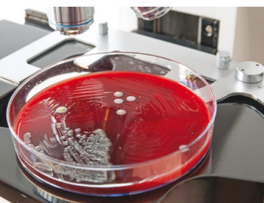
Monitoring antimicrobial resistance (AMR) in our environment
Engaging citizens through citizen science

Slide 3
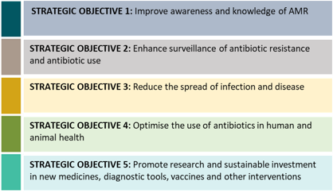
Action on AMR – iNAP and iNAP2

Slide 4
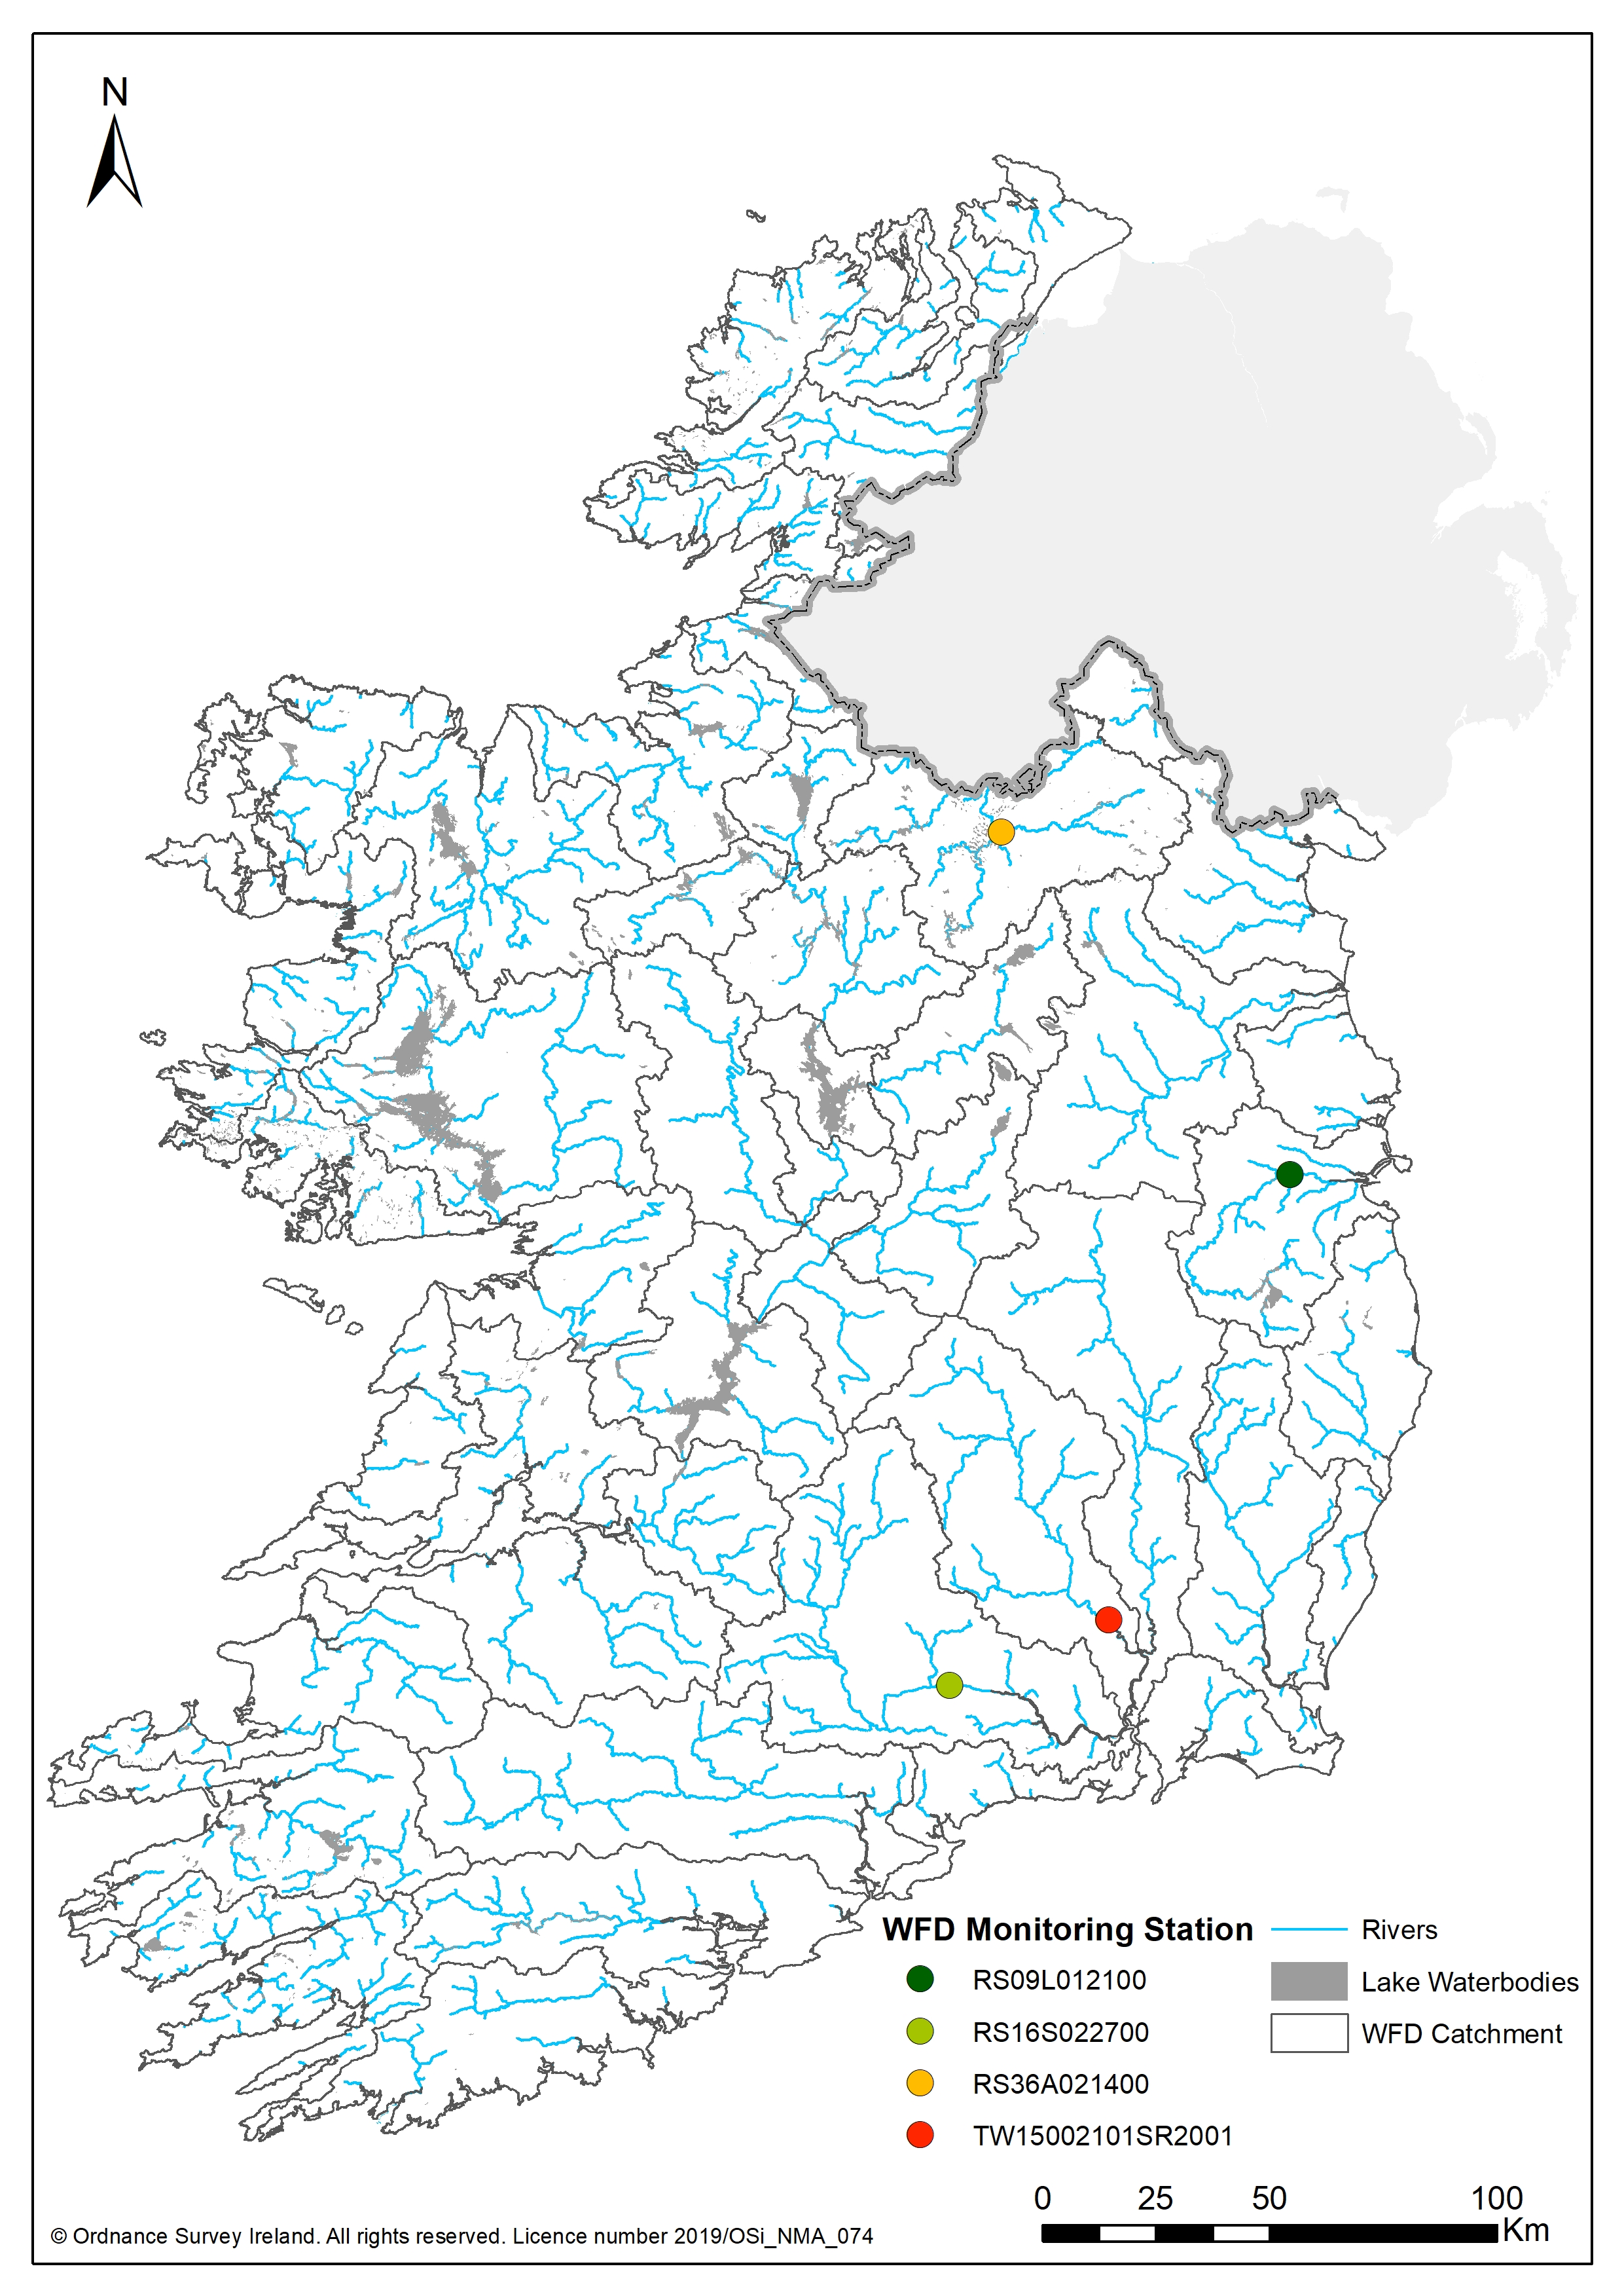
WFD Watch list monitoring
Liffey at Lucan Bridge
Suir at Kilsheelan Bridge
Nore Estuary at Inistiogue
Annalee 0.2 km d/s Cavan
Objective – to find the substances
Large volume septic tanks
Wet/poorly drained soils
d/s of treatment plant with pharmaceutical facilities emitting to plant
d/s of Industry / licence facilities
Possible misconnections
d/s of a town
d/s from agricultural pressure (tillage and pasture).

Slide 5
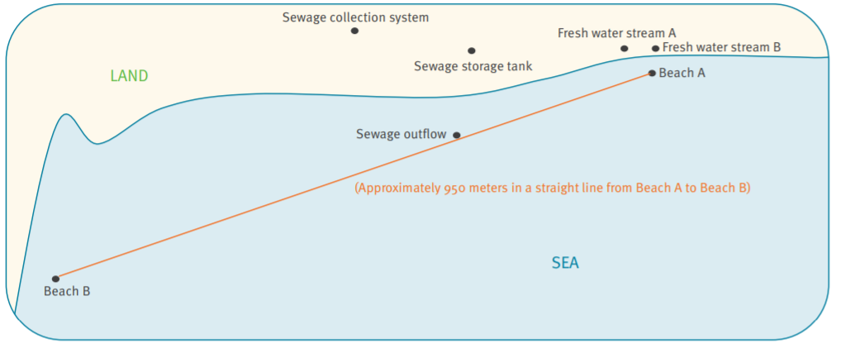
Clinically relevant AMR bacteria in our Environment
First reported finding of this clinically relevant AMR bacterium in bathing waters in Europe
Isolates of the CPE derived from the sewage collection system, the sewage storage tank and the outflow were 100% identical to those derived from a fresh water stream on one of the beaches, and to a clinical isolate
Bathing water in the area was consistently of sufficient quality

Slide 6
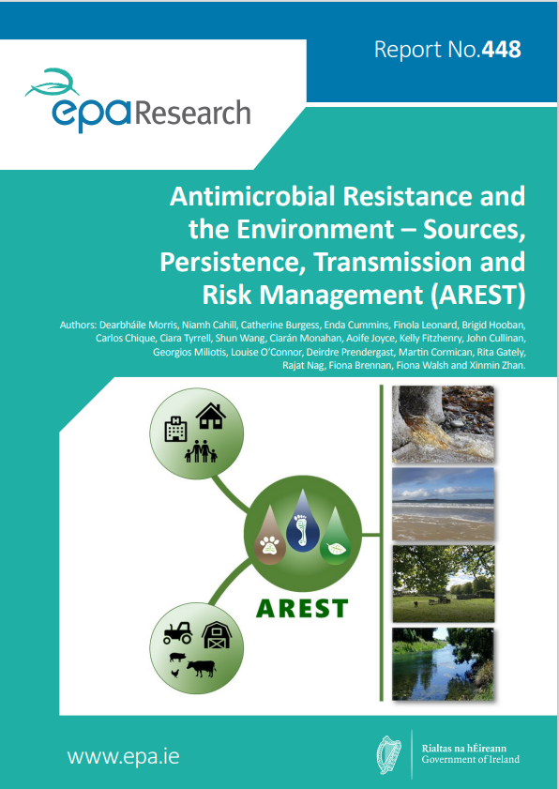
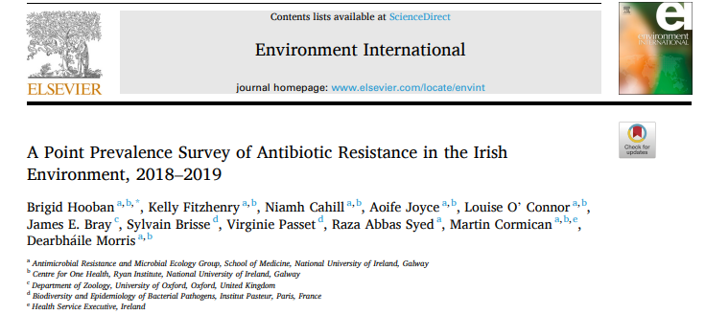
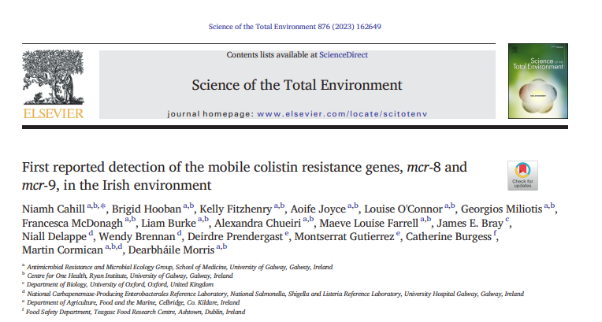
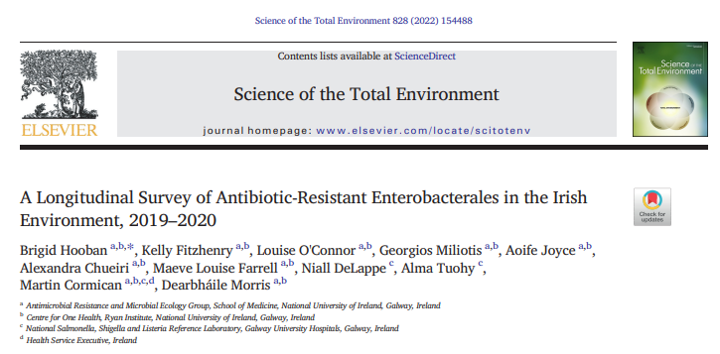
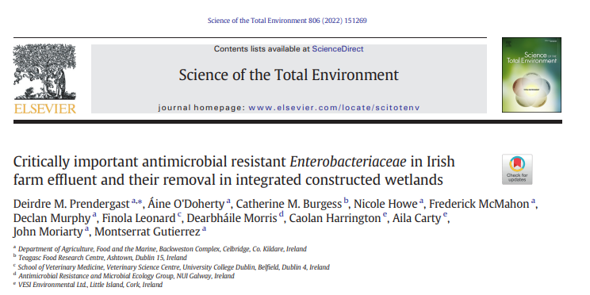
AREST project
“Results highlight need for regular monitoring of waters for AMR” “Harmonised monitoring approach needed for environmental resistance surveillance”

Slide 7
Harmonised European survey of AMR in surface waters
Need to improve our understanding of the occurrence of AMR in surface waters, especially downstream of urban wastewater treatment facilities and in bathing/recreational waters
Aims:
i) to run a pilot survey of AMR in surface waters during 2024, enabling the first harmonised data collection and reporting of the selected resistance genes at European scale, and
ii) to build capacity and experience for more quantitative monitoring in future.

Slide 8
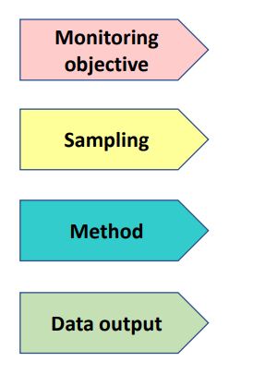
Harmonised European survey of AMR in surface waters
AMR dissemination and transmission, impacts of WWTP ….
Harmonised protocols developed for sampling locations, frequency, collection approach, sample handling and processing
Agreed analytical methods being used - qPCR and culturing.
Data collection, interpretation, output – data flow developed by EEA

Slide 9
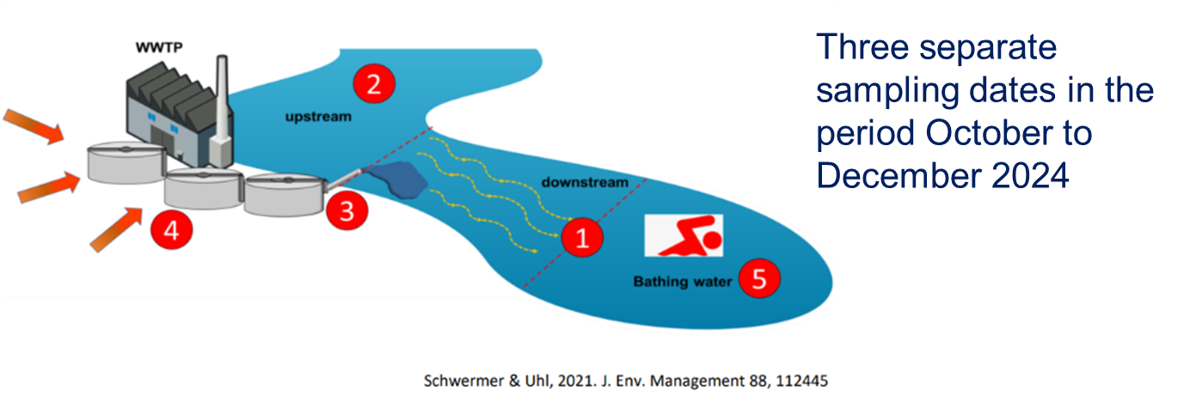

Slide 10
Clean Air Together

Slide 11
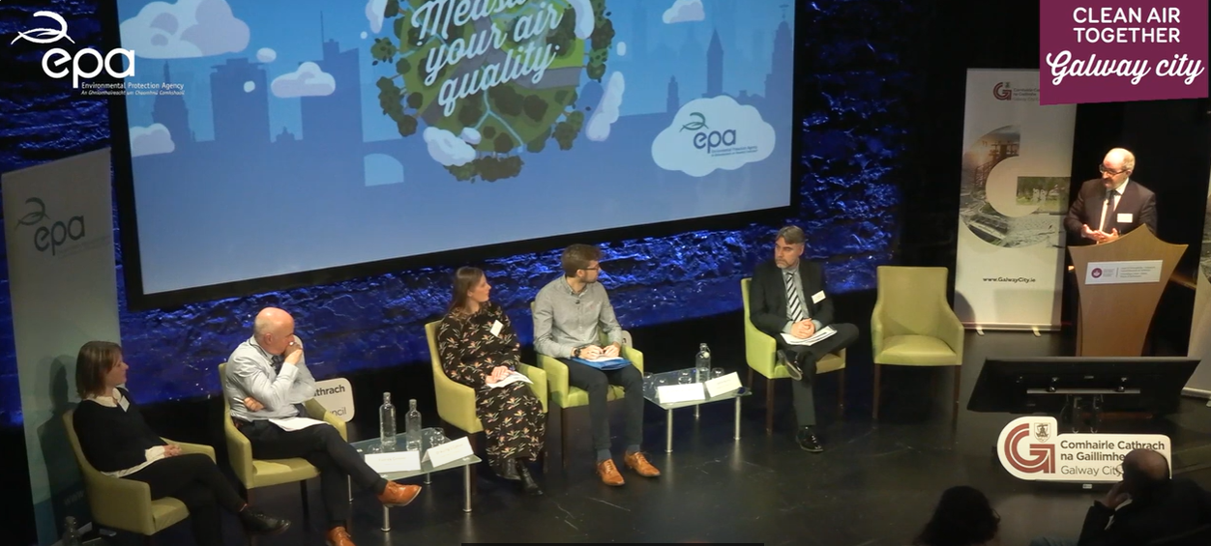
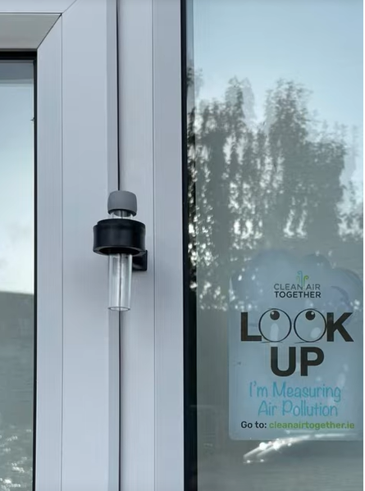
Clean Air Together
August
Recruitment
October
Measurement
February
Results

Slide 12
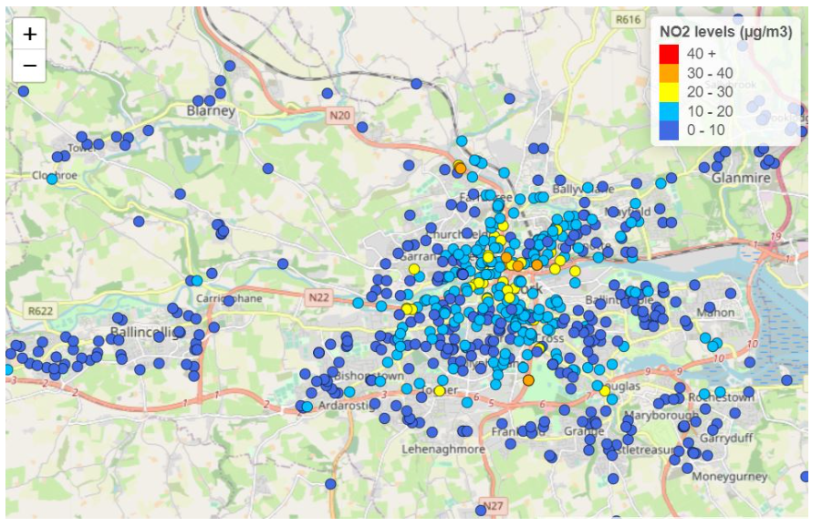
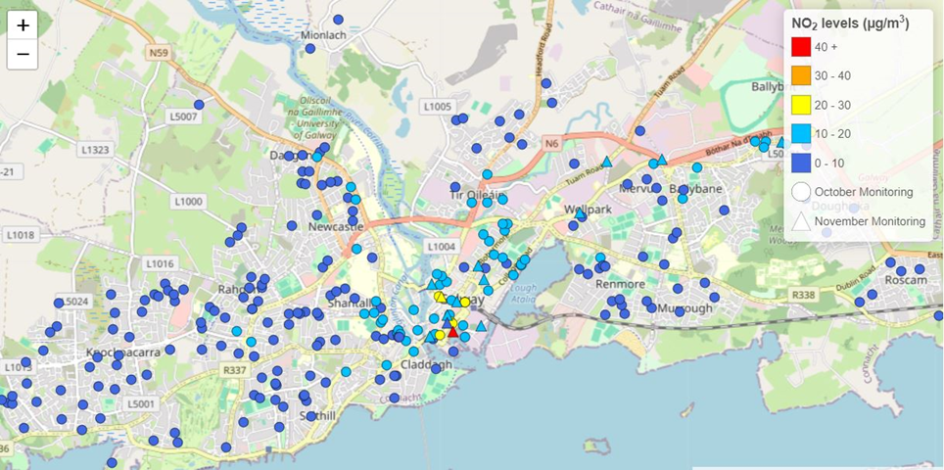
Dublin – 2021
1,000 participants
Cork – 2022
700 participants
Galway – 2023
300 participants

Slide 13
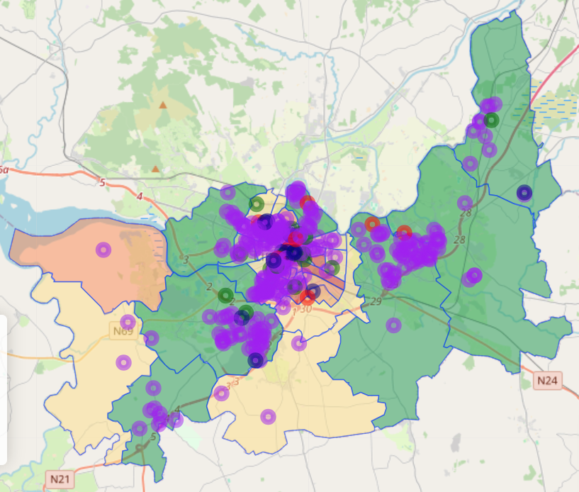
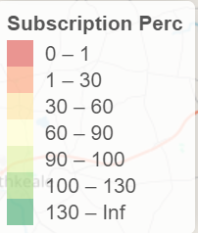
CAT Limerick Recruitment
In collaboration with EPA Analytics team

Slide 14
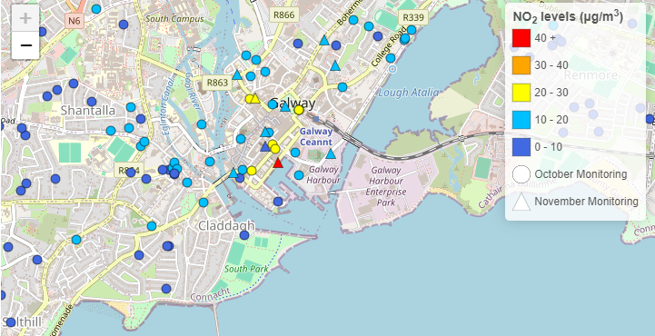
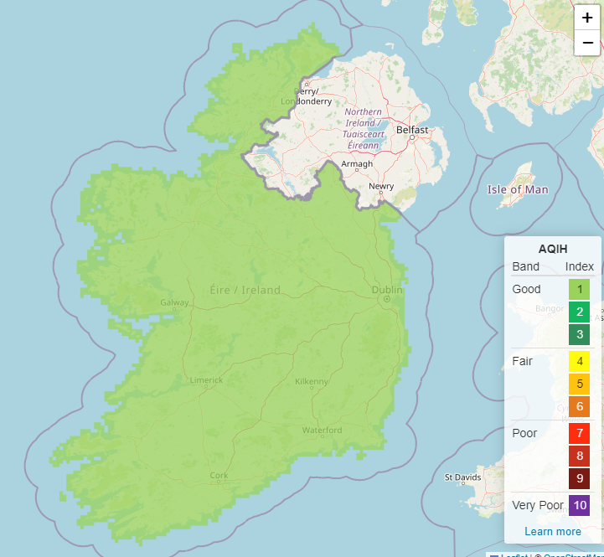
How we use the data

