Slide 1







OVERVIEW
EIONET Ireland Network visit by EEA
Thursday 17th October 2024
Dermot Burke, Air Specialist, National Ambient Air Quality Unit, EPA

Slide 2

Main Objective
The main objective is to strengthen air quality management in Ireland to ensure effective implementation of the EU Ambient Air Quality Directives

Slide 3







Project Details
LIFE19 GIE/IE/001101- LIFE Emerald
Emissions ModEling and FoRecasting of Air in IreLanD
Start: 01/01/21 - End: 30/09/24
Total: €1.6 million 52% of which is EC Co-funded
Coordinating Beneficiary – EPA
Associated Beneficiaries - ASI , DECC , HSE , UCC, VITO
Notes:
3 main outputs: 3-day forecast, Now-cast maps, historical annual maps

Slide 4













Project Stakeholders

Slide 5
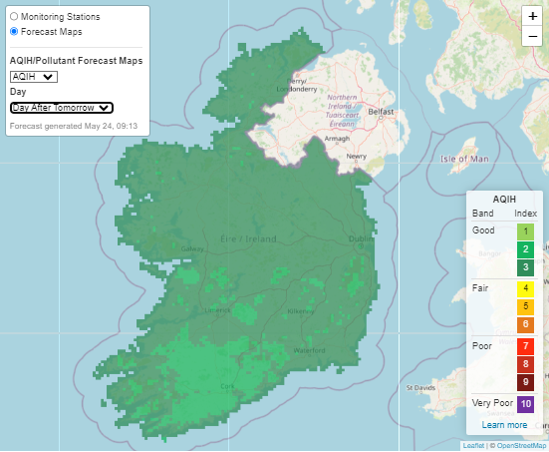
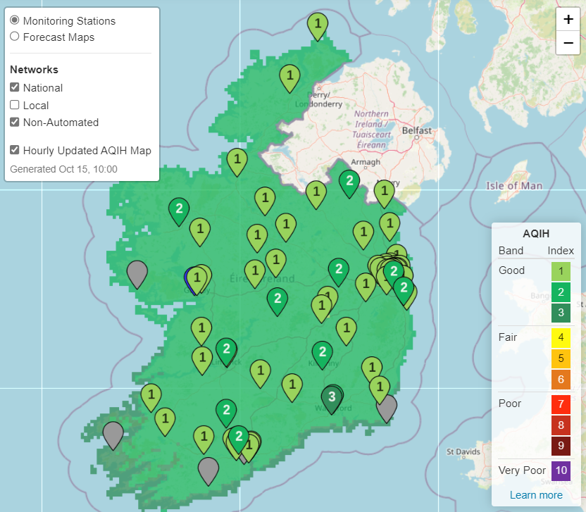
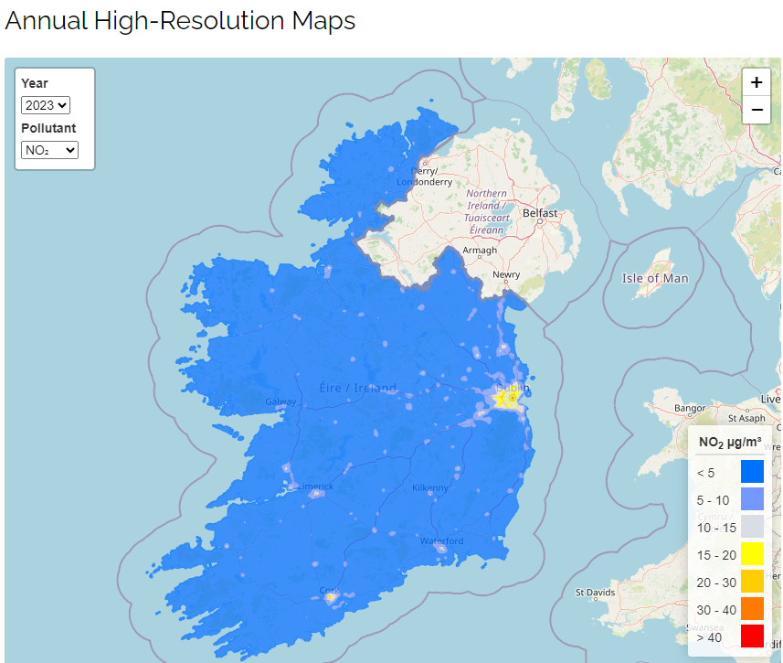
Main LIFE EMERALD deliverables
Main Deliverables:
  Up to 3-day forecast for Ireland verified with DELTApy tool
  An hourly updated AQIH map for the whole country
  Production of annual historical maps both nationally & city level
  All available on www.airquality.ie

Slide 6
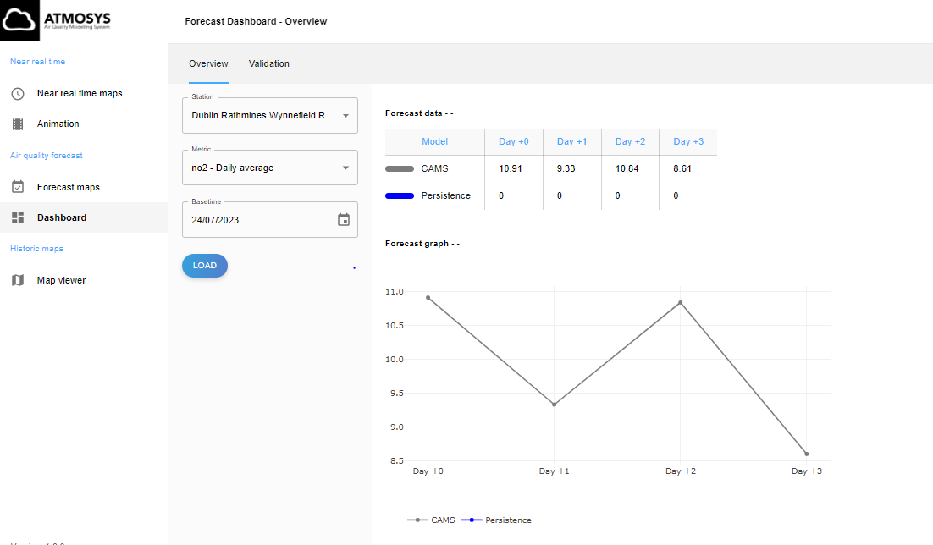
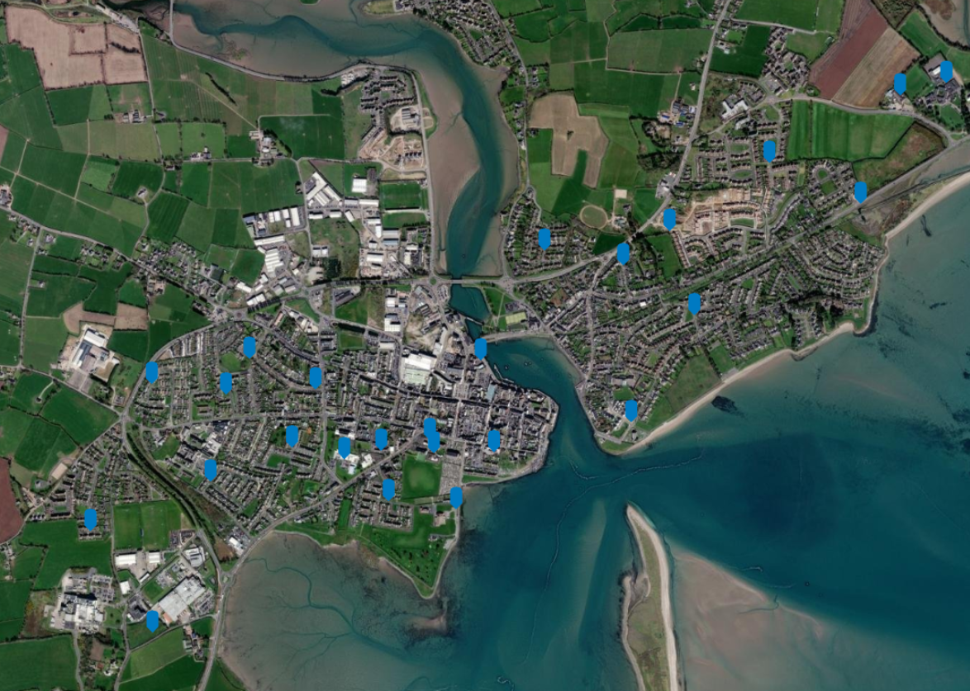
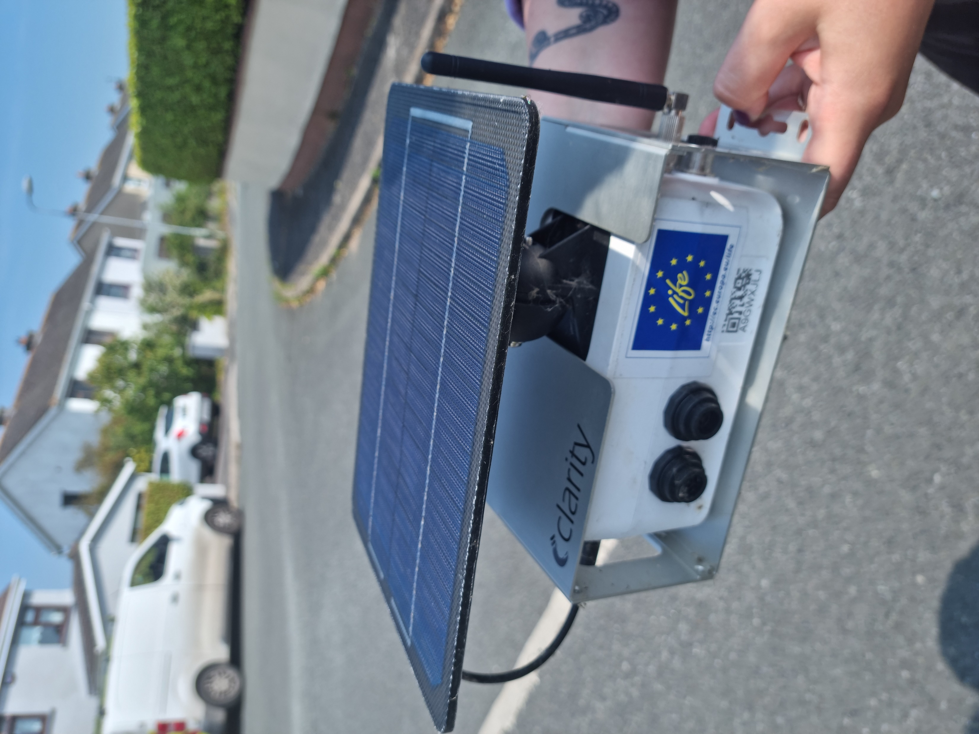
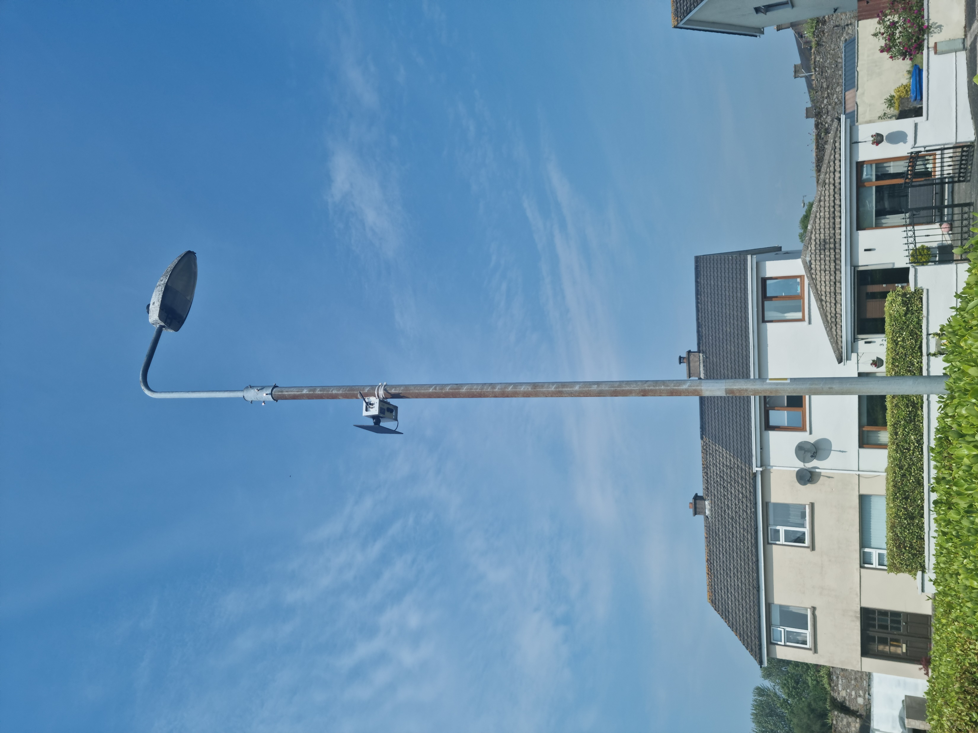
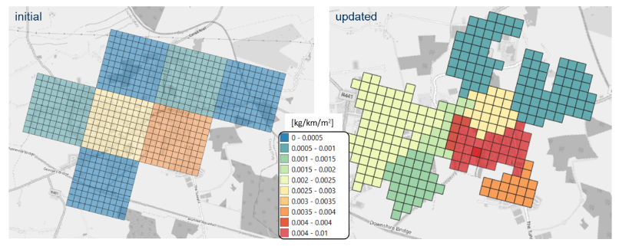
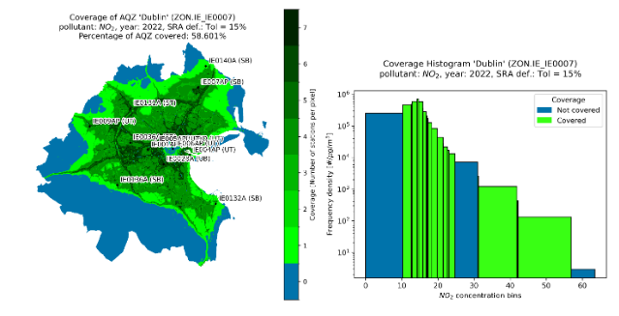
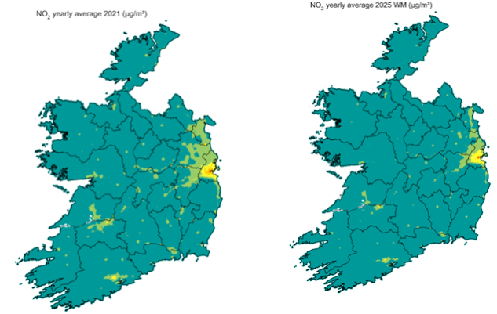
Other LIFE EMERALD deliverables
Internal AQ management dashboard
Measurement campaigns to validate modelling chain
Improving residential solid fuel emissions data
Spatial representativeness study of AQ monitoring network
Assessment of impact of AQ policy measures
Supporting local AQ measures & plans

Slide 7
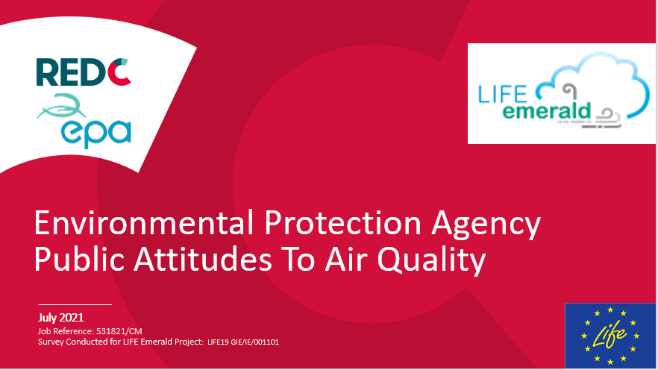
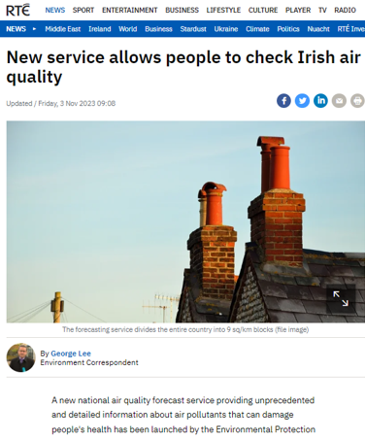
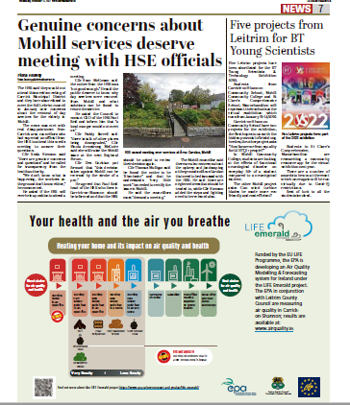
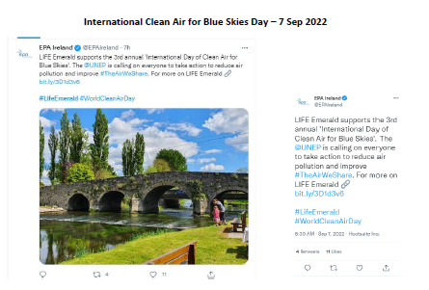
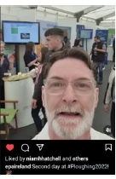
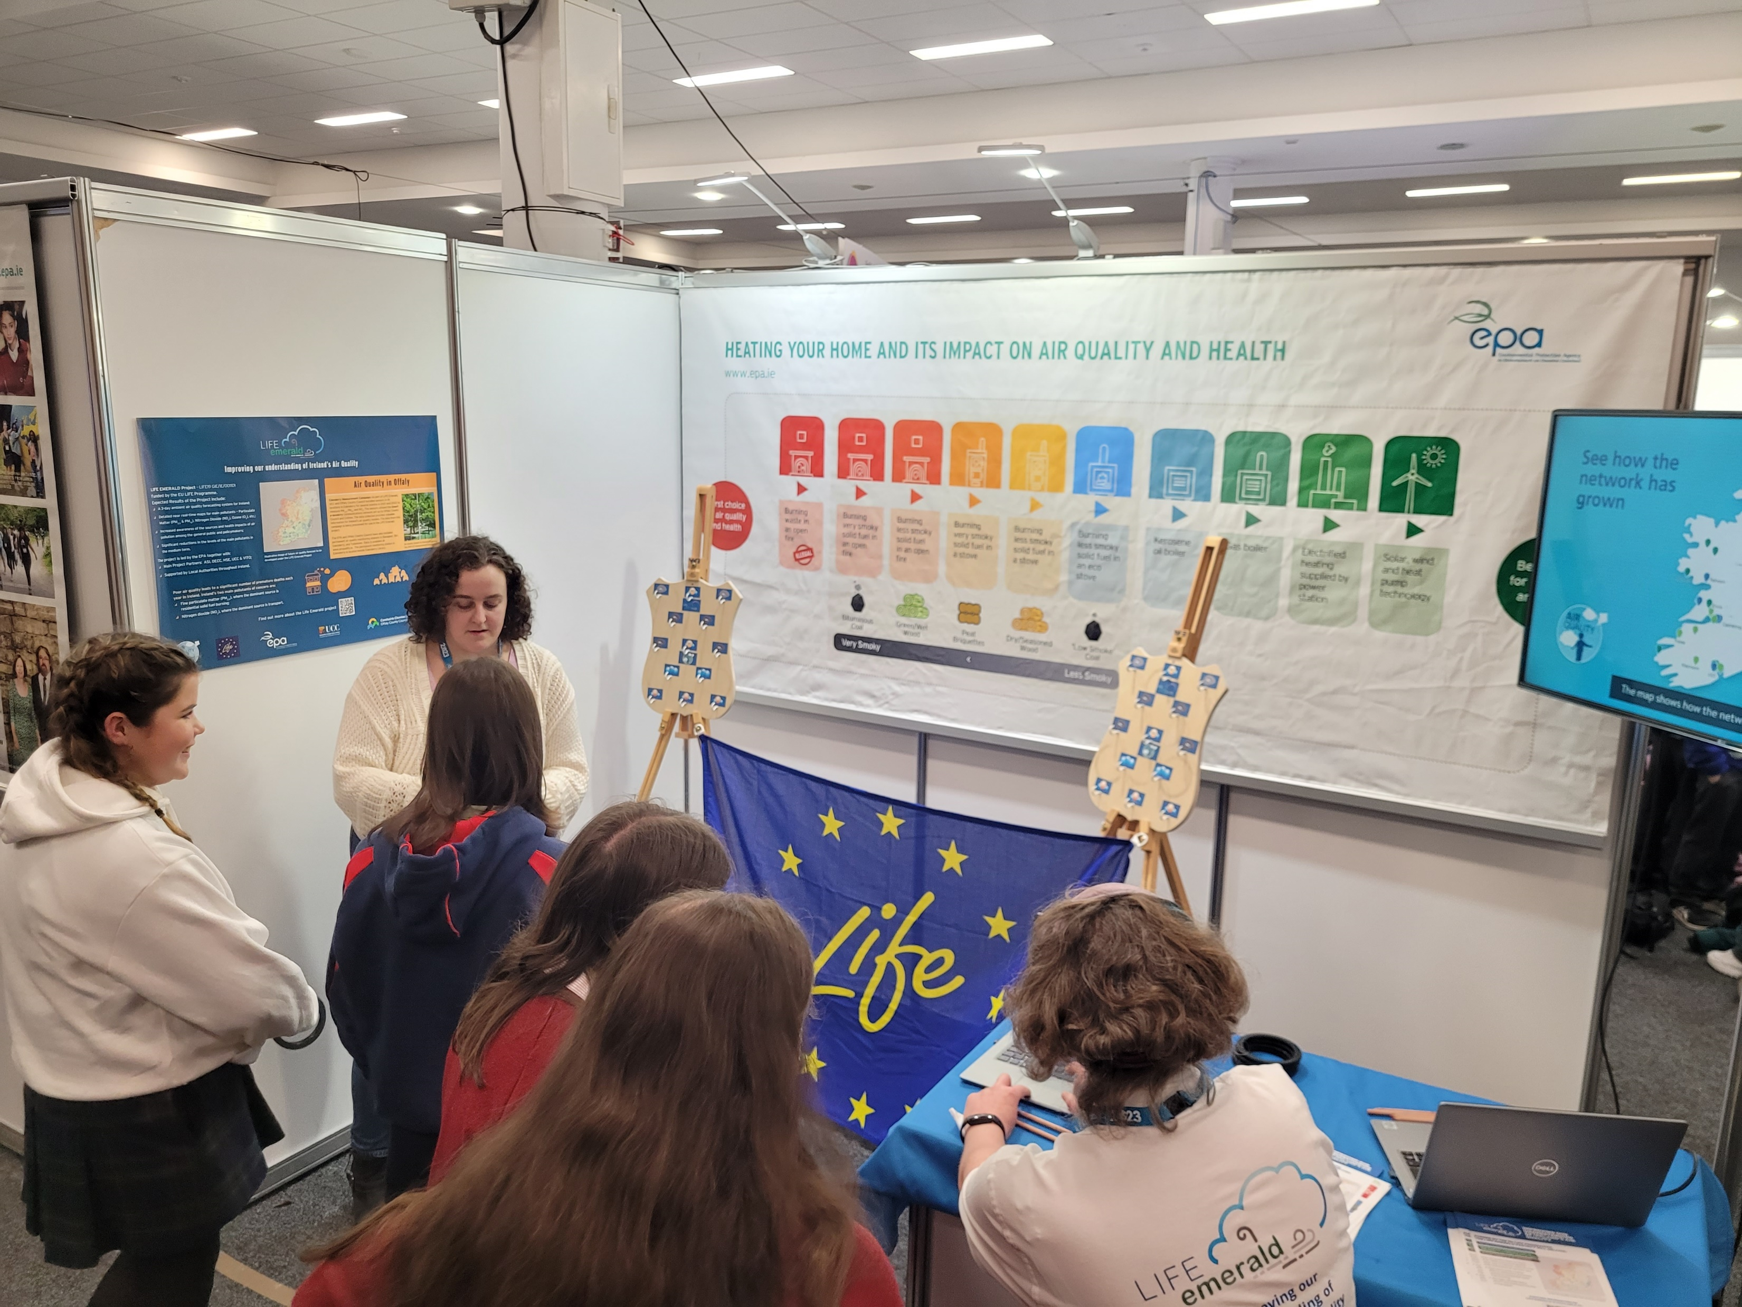
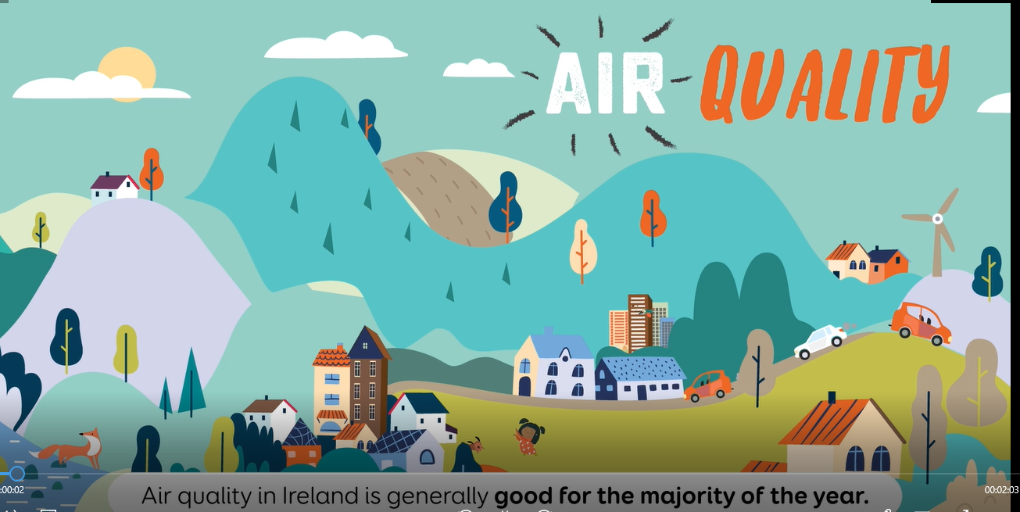
Public Outreach & Dissemination
National AQ awareness, attitudes & behaviour surveys
National & targeted local media campaigns
Promotion on social media
Attending public events
AQ animated video for CHI Temple Street

Slide 8
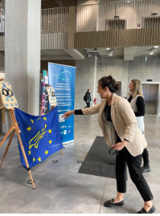
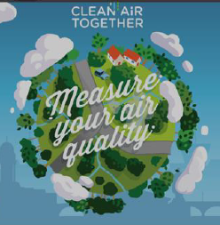
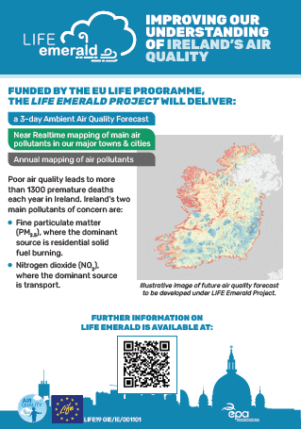
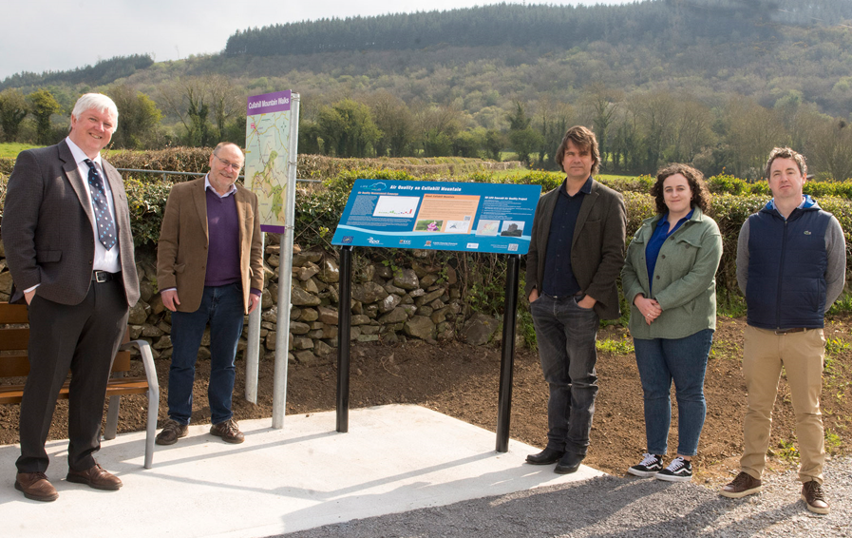
More Public Outreach & Dissemination
LIFE Emerald & airquality.ie websites
Giving talks in schools & universities
Integration with Citizen Science projects
Production of LIFE Emerald notice boards & leaflets
ASI health care professional webinar

Slide 9
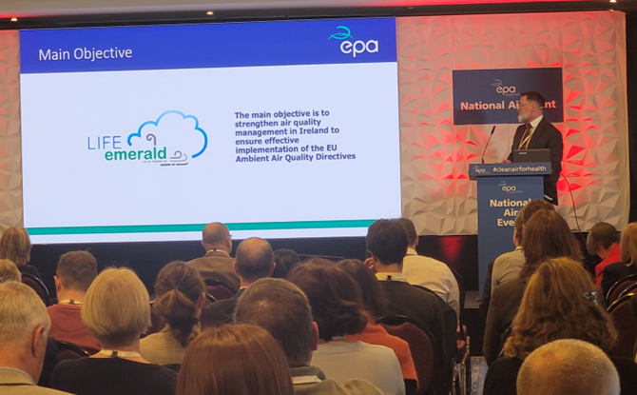
Irish Policy Makers Outreach & Dissemination
Stakeholder network platform Air Quality Health Information Working Group
National Air Event & National Modelling Forum
Meetings with Irish policy makers e.g. DECC, DoT, NTA, the Urban Transport Related Air Pollution Forum, the National Demand Management Strategy
Completed a Policy Briefing Report
Worked with and briefed LAs, including Offaly Co. Co. & Waterford City & Co. Co. on monitoring networks, Dublin LA’s on the model development, the majority of LA’s at recent LA Sensor Workshop

Slide 10
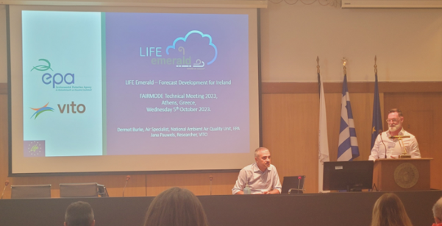
EU Outreach & Dissemination
Presented at EU FAIRMODE meetings in 2022, 2023 & 2024
On-going engagement with SEPA and DAERA
Knowledge transfer with Belgian IRCEL (Interregional Environment Agency), colleagues in Croatia & Malta
LIFE Emerald presented at EC Ambient Air Quality Expert Group in Oct. ’21 & HungAIRy International Conference on Air Pollution in Nov. ‘21
Shared information with LIFE IP Malopolsksa on Irish anti-smog legislation

Slide 11
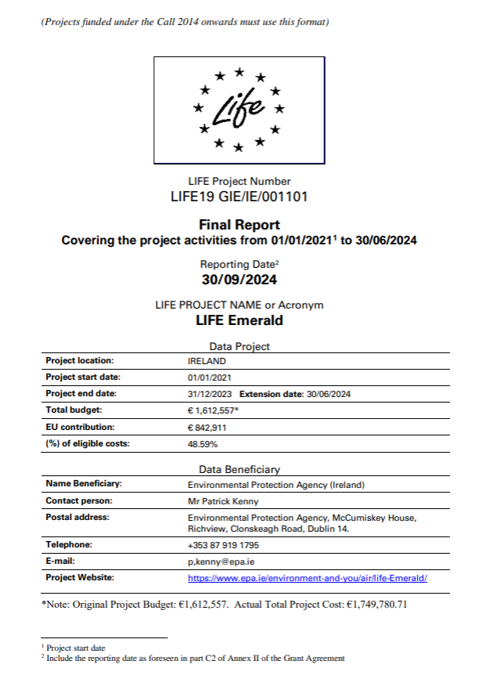
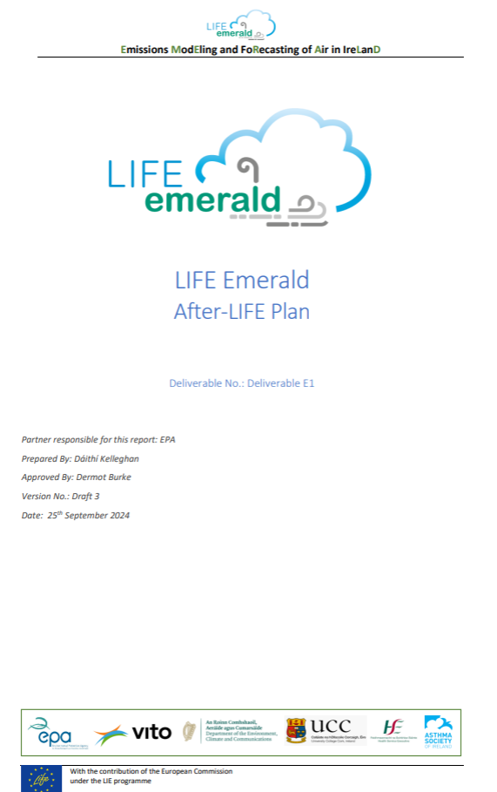
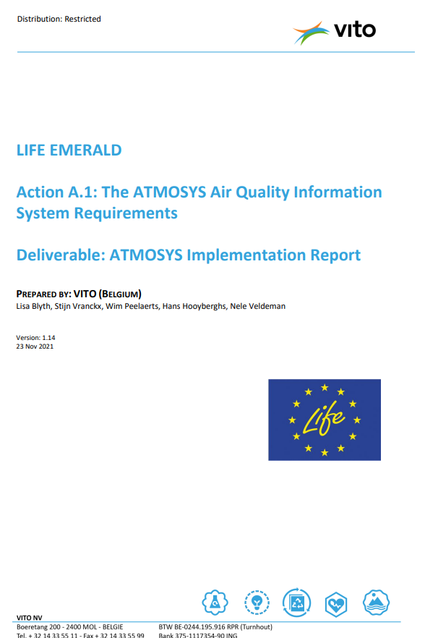
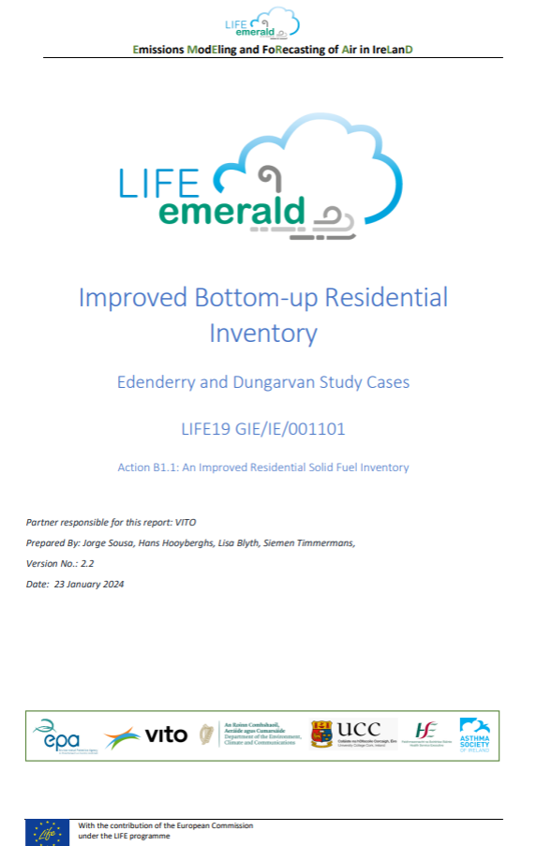
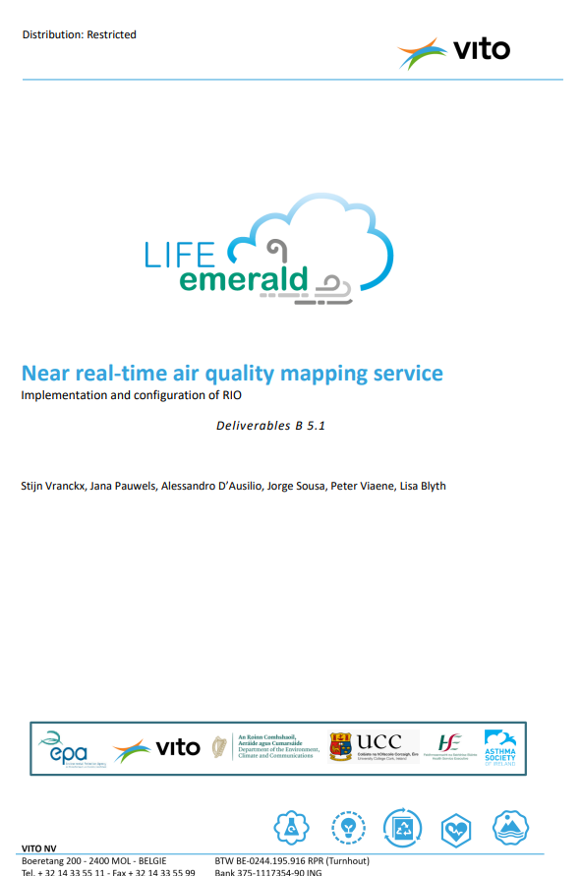
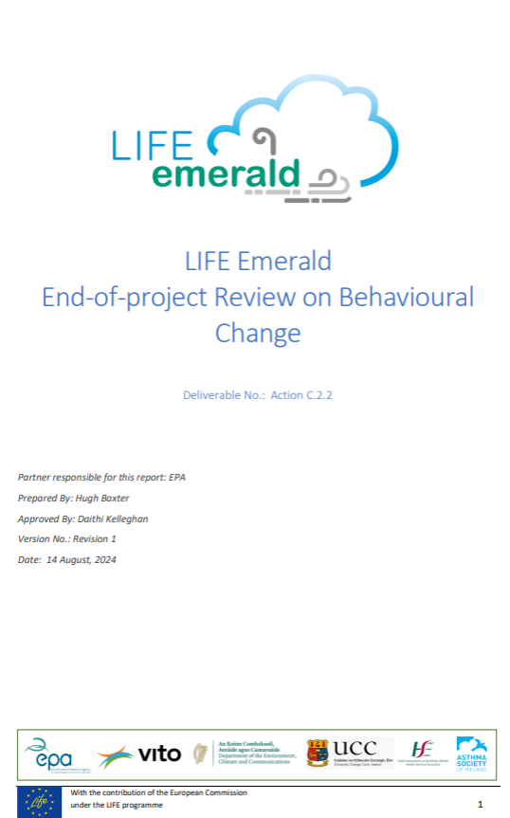
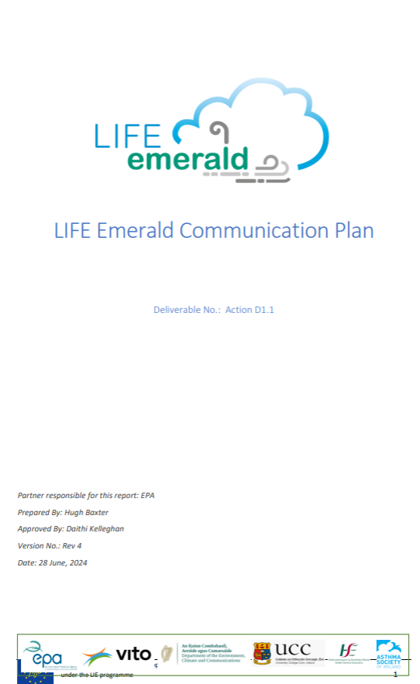

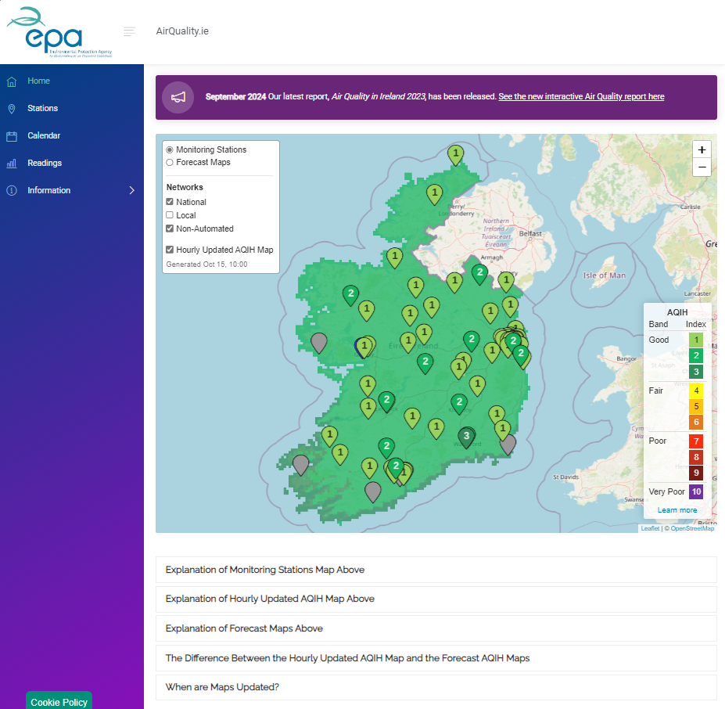
Final Reporting
Final project report
35 Individual reports on each project deliverable
Layman’s report
After LIFE report
www.airquality.ie

Slide 12
Thank You!

