Slide 1




Climate Change in the Irish Mind
Presented by: Dr. Desmond O’Mahony Behavioural Insights Team, EPA
Contact: d.omahony@epa.ie

Slide 2

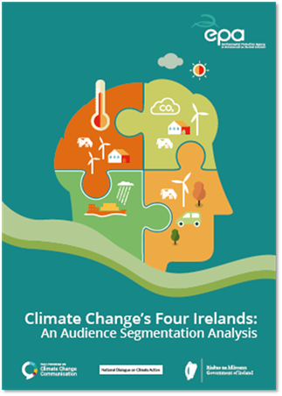
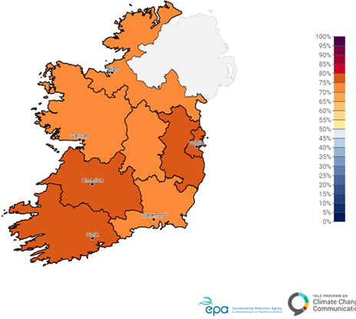
Climate Change in the Irish Mind
Climate Change in the Irish Mind (CCIM) is a large-scale, nationally representative survey of the Irish population’s climate change beliefs, risk perceptions, policy preferences, and behaviour towards climate change
Begun in 2021 by the Irish Environmental Protection Agency with support from the Yale University Program on Climate Change Communication
Key outputs relevant to policy makers and the public alike

Slide 3
CCIM Wave 2 Methodology
Core and modular survey topics:
  Wave 1: 56 questions, Wave 2: 53 questions (25 min)
  Subtopics removed: Climate change media sources, Political intentions
  Major topic added: Climate literacy
Fieldwork CCIM Wave 2 (conducted by IPSOS B&A in 2023)
  Random digit dial, Computer Assisted Telephone Interview
  1,330 interviews, Quota controlled and nationally representative

Slide 4
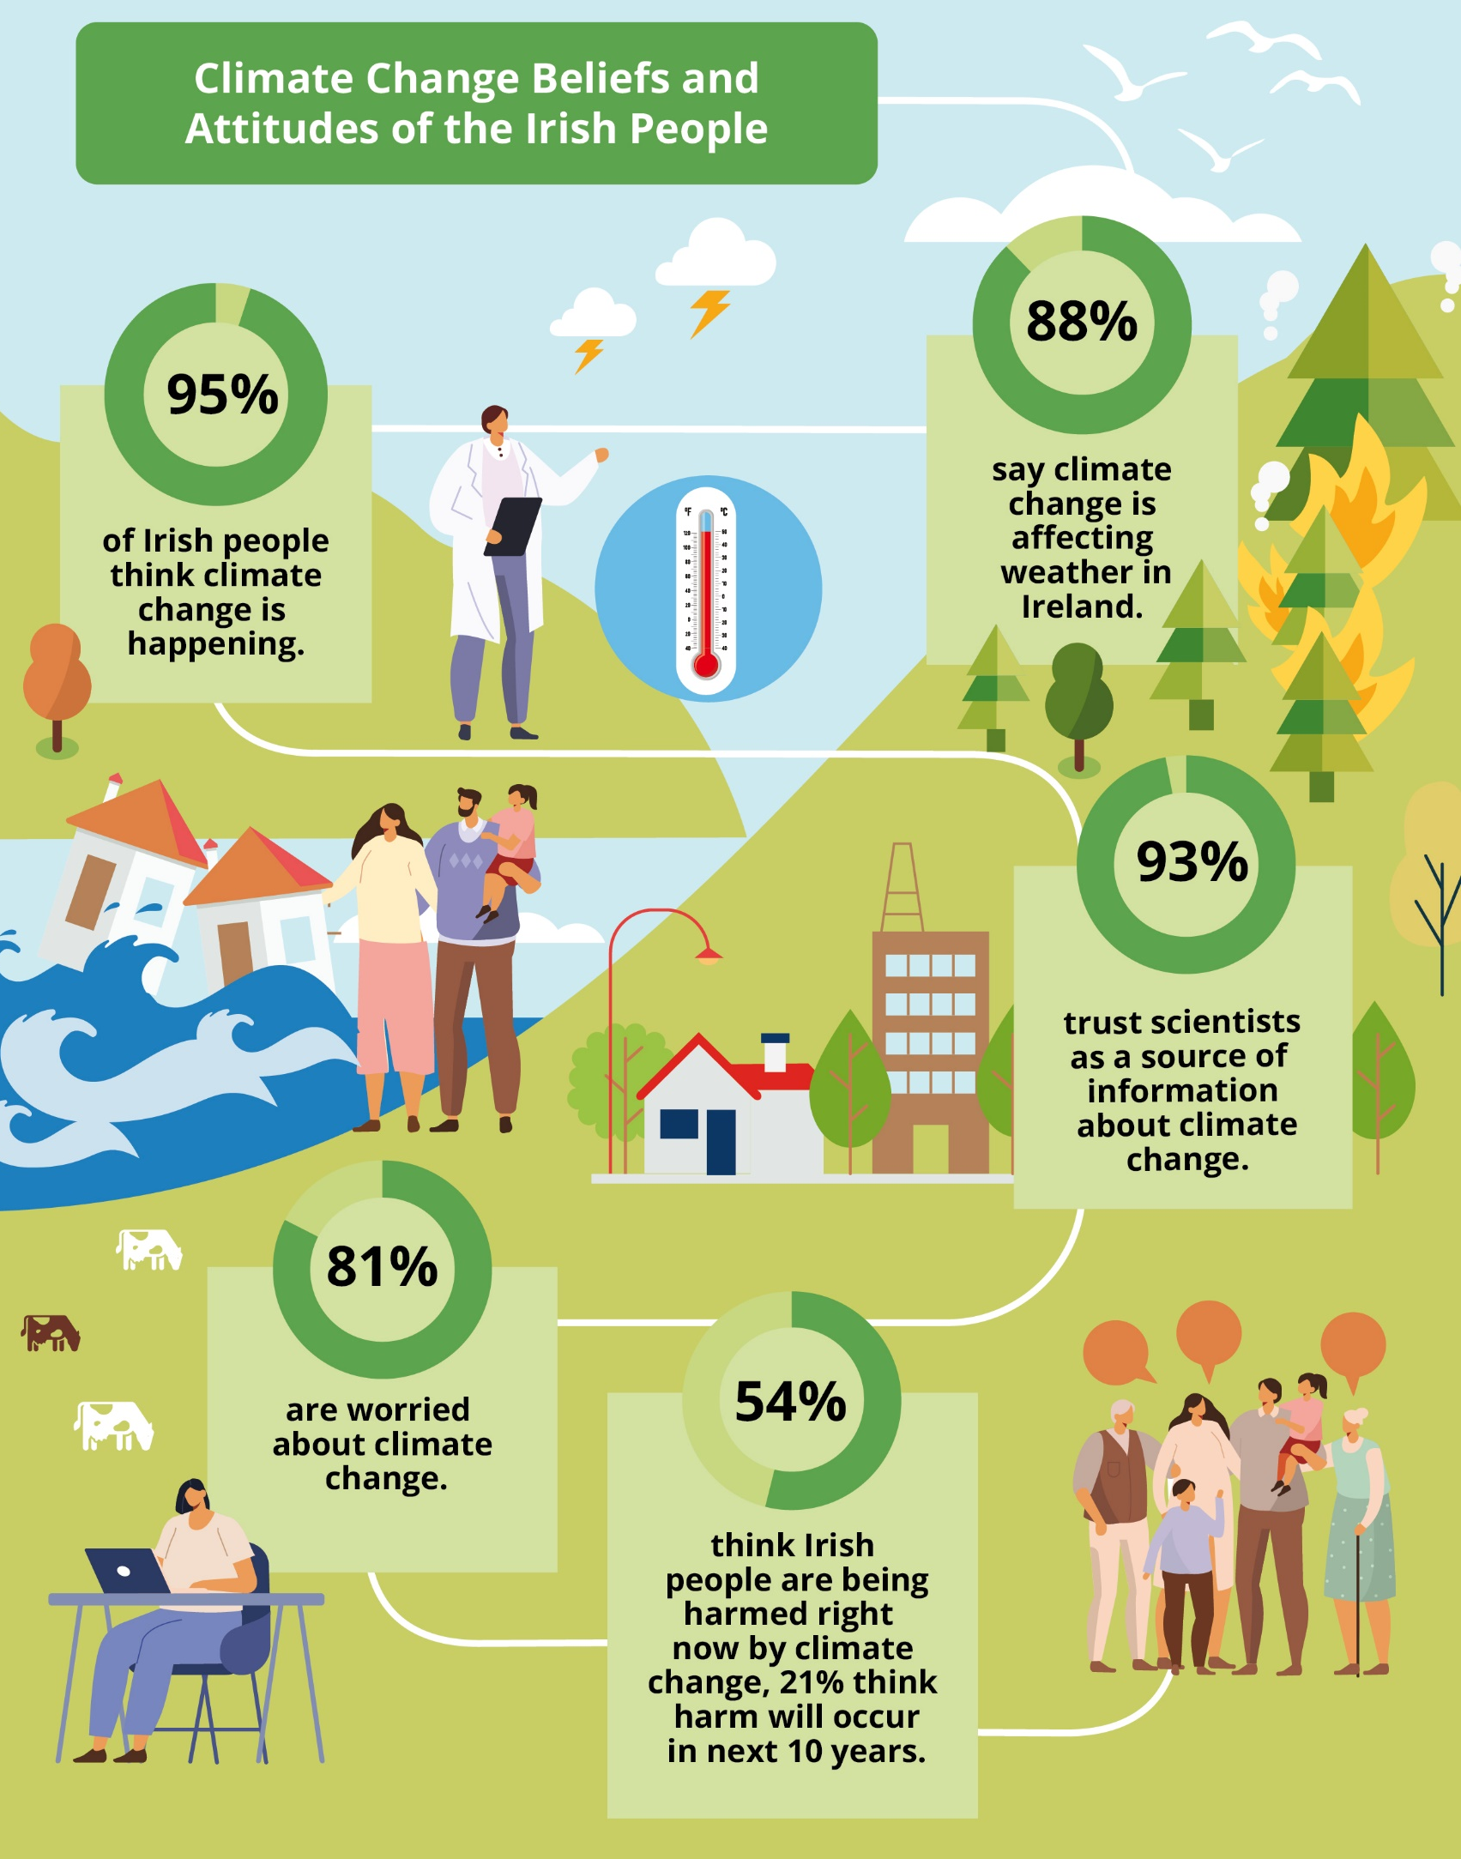
Climate Change
Beliefs and Attitudes
Most climate change beliefs remain consistent between 2021 and 2023
Overall worry remains high
Some overall change in pattern of worries about local hazards
  Water pollution (79%)
  Severe storms (64% → 74%)
  Extreme heat (45% → 54%)

Slide 5
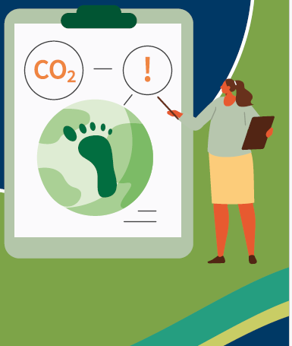
Engagement with Climate Change
Personal engagement on climate change
89% say climate change is important to them personally
78% “often” or “occasionally” discuss climate change with family and friends
82% understand scientific consensus on climate change
Media Engagement on climate change
Strong increase in engagement ‘at least weekly’ in the media
        (51% in 2021 → 74% in 2023)
High levels of trust in mainstream media (68%) and in journalists (68%)
Desire for the media to do more on climate change (71%)

Slide 6
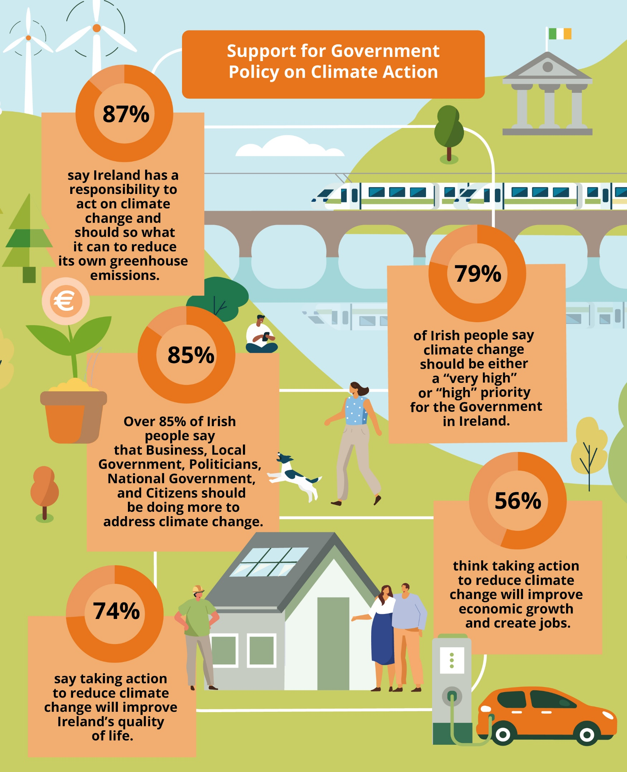
Support for Government
Climate Action Policy
Positive outlook on political, economic, and quality of life topics
Outlook does not differ by experience of economic difficulties
Strong desire for leadership on climate action from Government

Slide 7
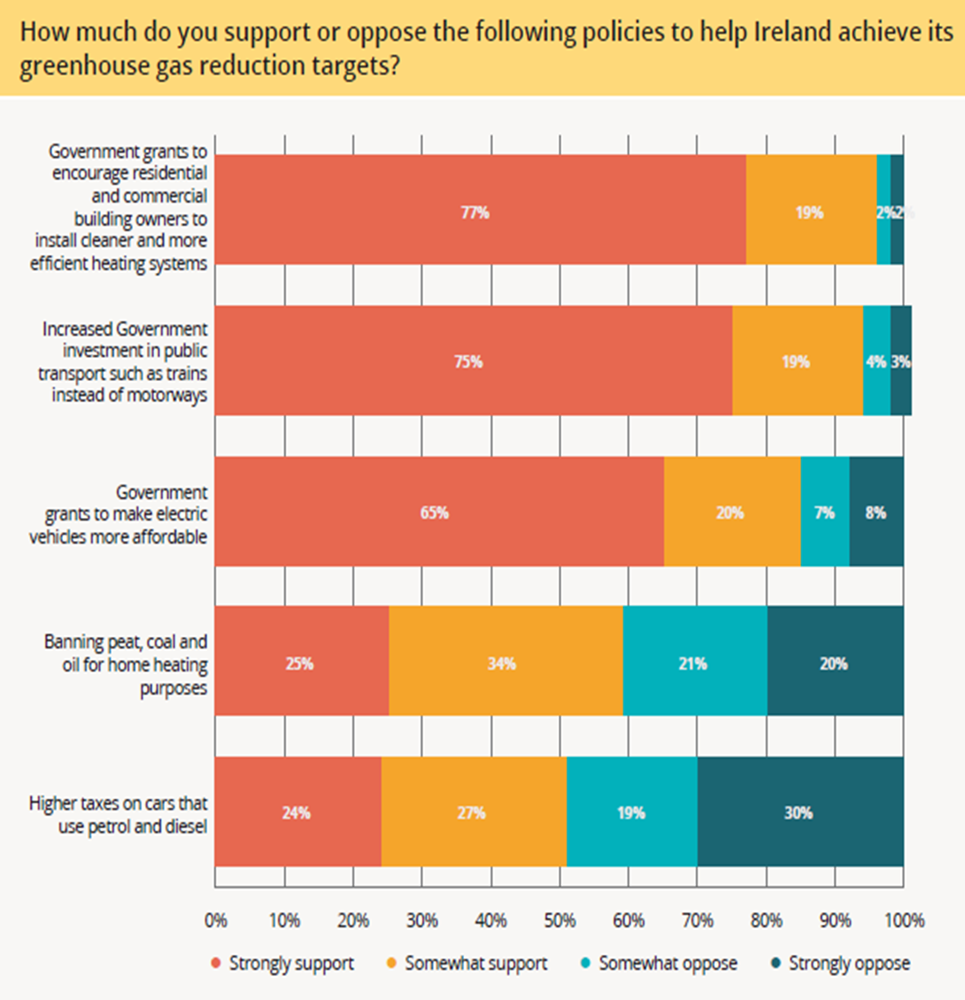
Support for Government Climate Action Policy
Overwhelming support for policies of systems change to support climate action
Support for policies that affect non-discretionary spending has weakened
  ‘Banning peat, coal and oil for home heating’ 68% → 59% overall support
  ‘Higher taxes on cars that use petrol or diesel’: 64% → 51% overall support

Slide 8
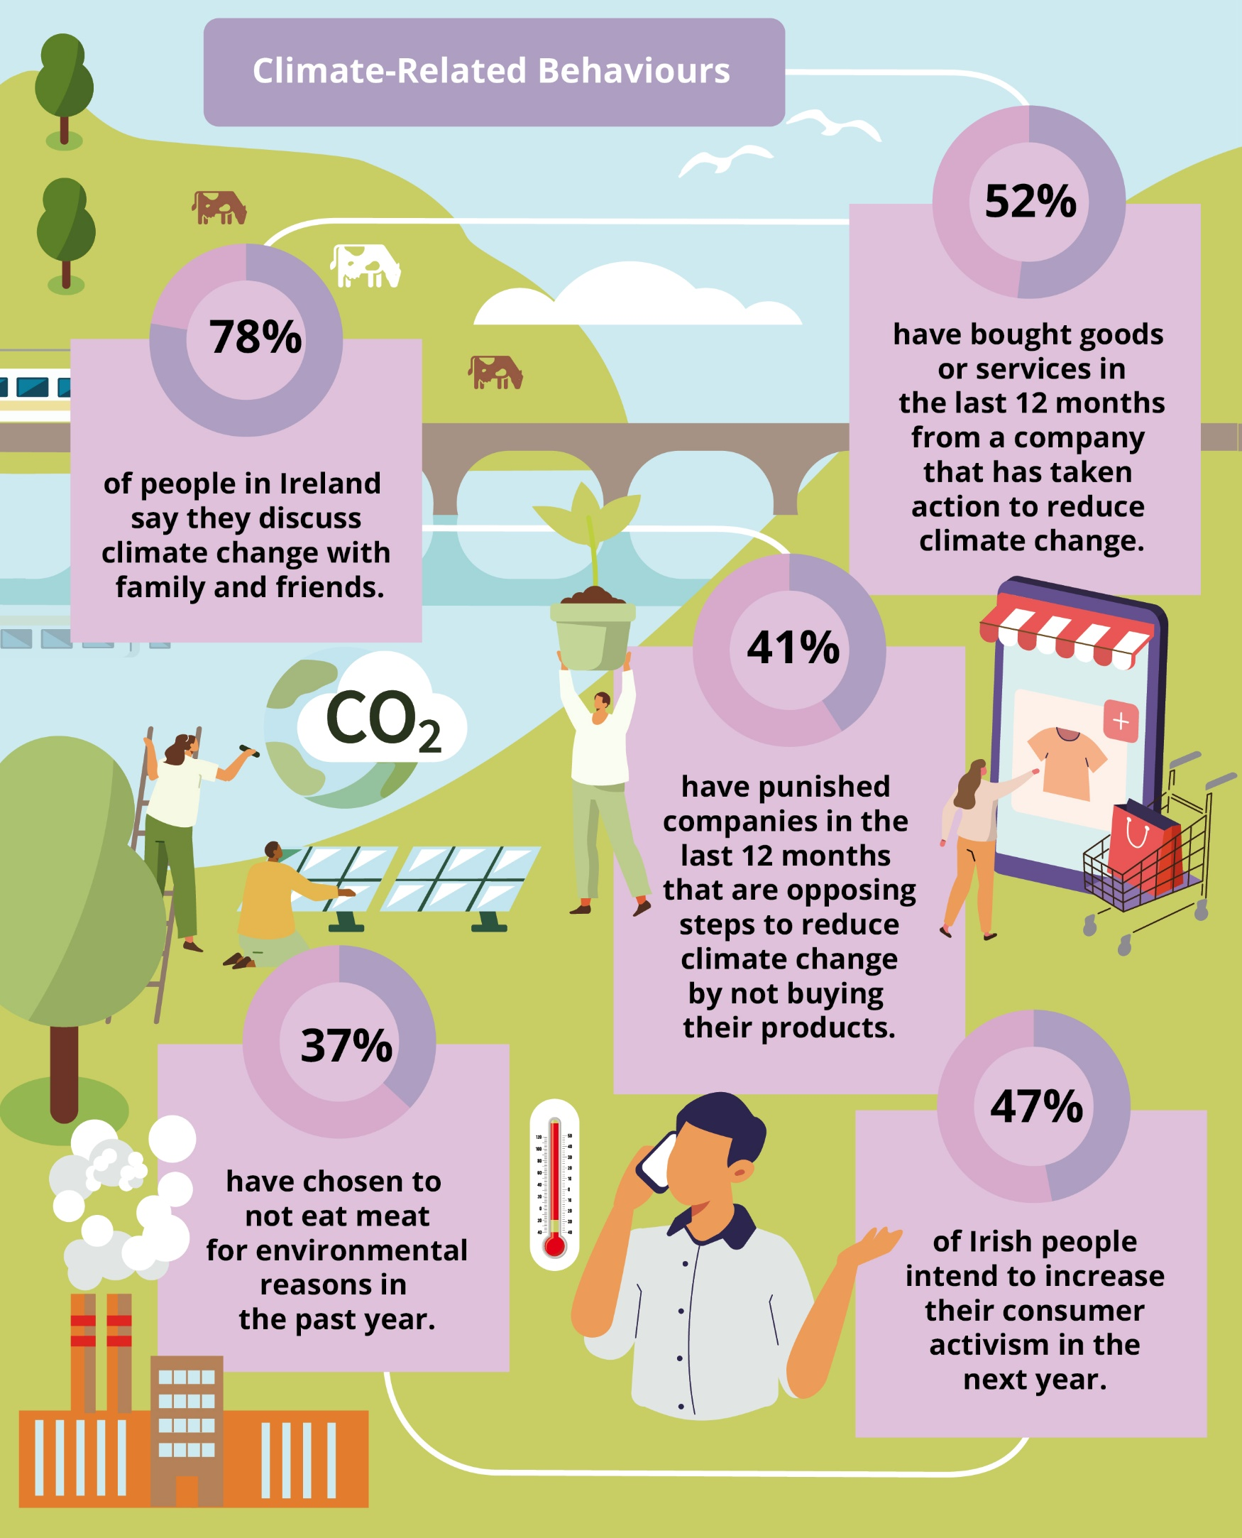
Climate-Related
Behaviours
Understanding normative behaviours has a strong influence on perceptions of the ease or difficulty of taking climate action
Key importance of communicating norms around climate change behaviours in strategic communications

Slide 9
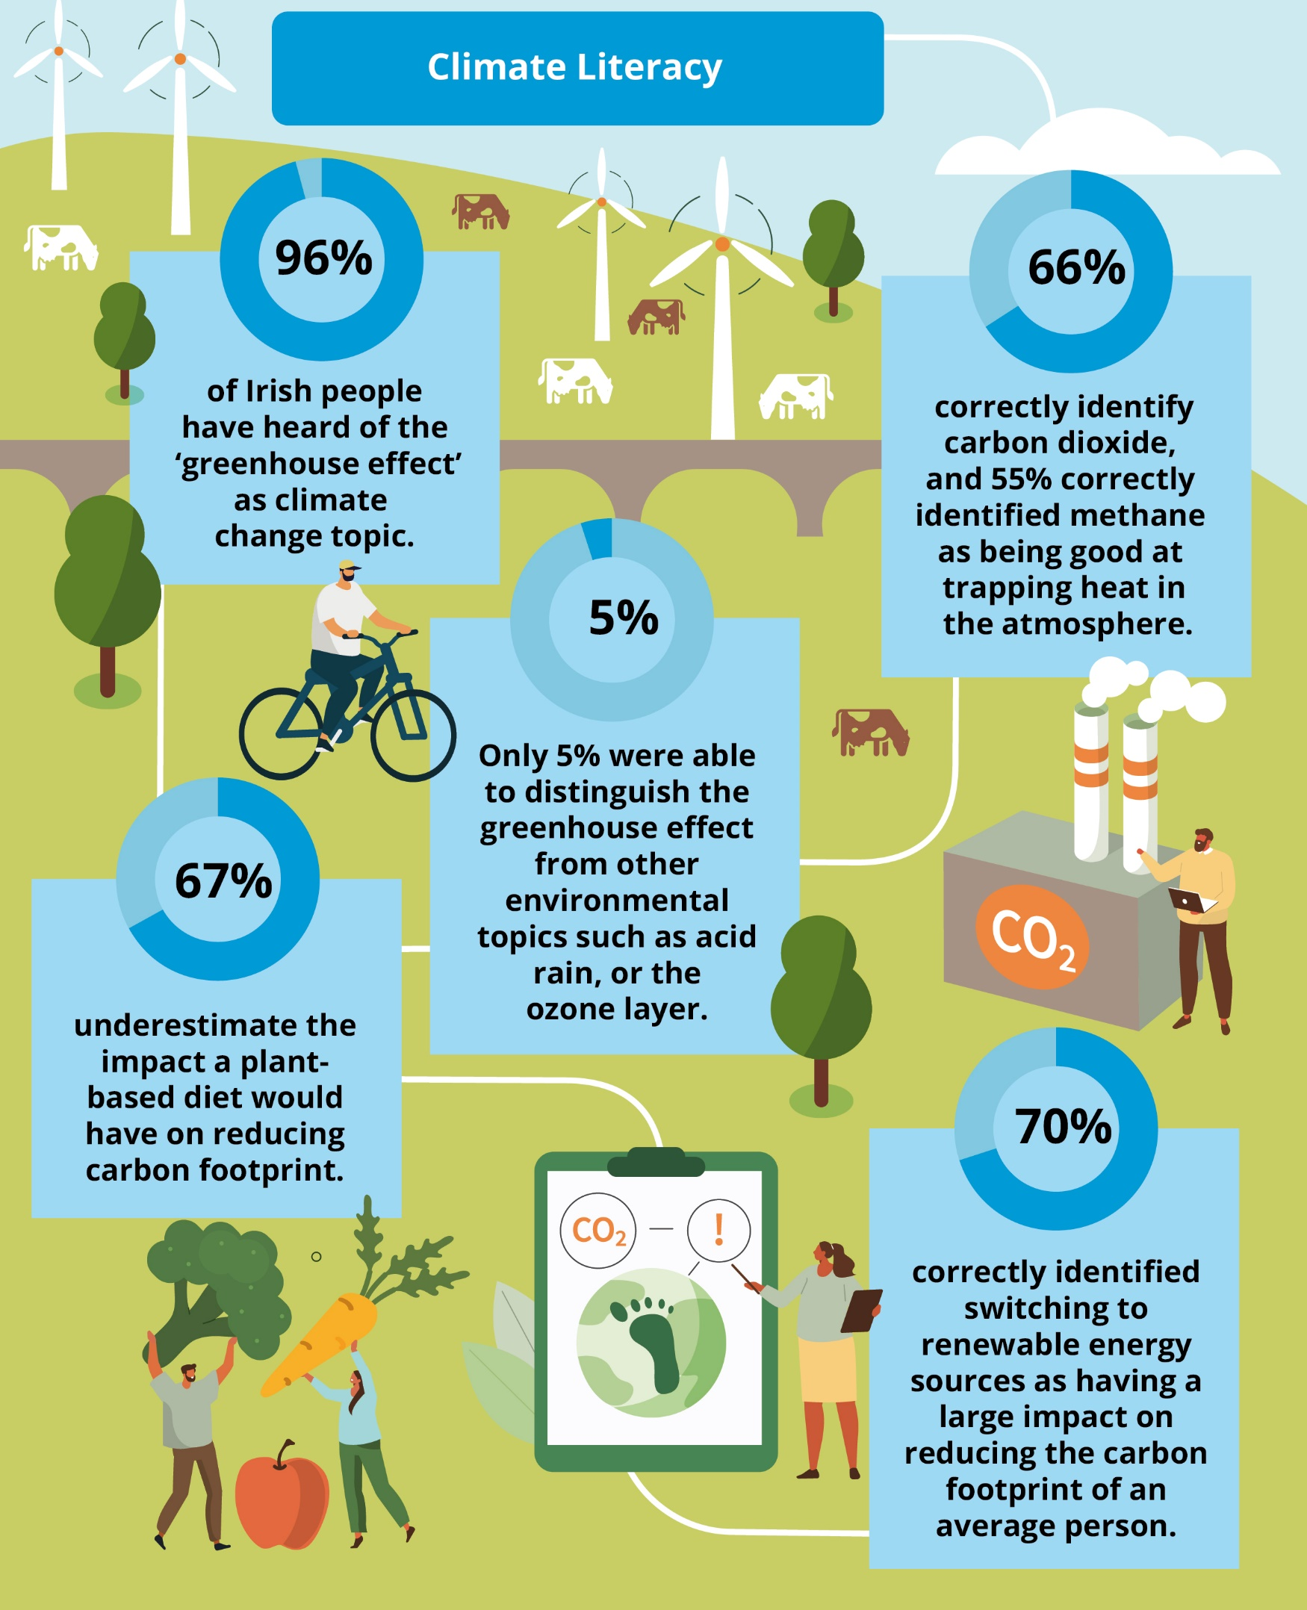
Climate Literacy
Climate literacy explored as both factual and applied knowledge
High recognition of climate change as a topic
Moderate understanding of factual content
Confusion between climate change and other environmental topics

Slide 10
Climate Change in the Irish Mind
Wave 2
Summary
Widespread agreement on many climate change attitudes and strong majority support for climate action
81% of people in Ireland are worried about climate change and 75% think extreme weather poses a moderate or high risk to their community over the next 10 years - Increase in worry about severe storms (74%) and extreme heat (54%).
89% report that climate change is important to them personally and 79% say climate change should be either a “very high” or “high” priority for Government, with overall support for a range of climate action policies.
Irish people think that climate action will increase economic growth and create jobs (56%), and actions to reduce climate change will improve quality of life in Ireland (74%).

Slide 11

Climate Change in the Irish Mind
Wave 2
Thank you
for your attention
Q&A

