Slide 1
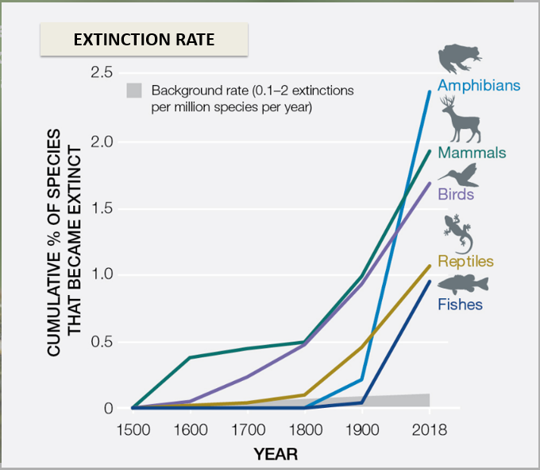
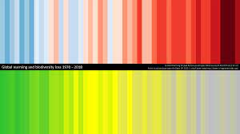
EEA’s Perspective on Recent EU Environmental Policy
Source:
Ed Hawkins, University of Reading
Miles Richardson, University of Derby
Source: EEA State of Nature report 2021
Source: IPBES summary report on biodiversity
Dr Brian MacSharry│18/10/2024│EIONET Ireland country visit

Slide 2
What drives policy…facing the Triple Planetary crisis
We are confronting an unprecedented "triple planetary crisis." These interconnected threats endanger us all & demand immediate action.
Climate change
Pollution
+
+
Triple Planetary Crisis
+
+
Biodiversity loss
Notes:
https://environment.ec.europa.eu/news/unea-6-united-action-needed-tackle-triple-planetary-crisis-2024-03-01_en

Slide 3
Building on some key pillars
European Green Deal (2019): Europe’s overarching strategy to become climate-neutral by 2050.
Key pillars: Climate action, clean energy, biodiversity protection, pollution reduction.
Fit for 55 Package (2021): A set of proposals aiming for a 55% reduction in greenhouse gas emissions by 2030 compared to 1990 levels.
Biodiversity Strategy 2030: Target to protect 30% of EU land and sea areas and restore degraded ecosystems.

Slide 4
Kunming Montreal Global Biodiversity Framework
There are 23 targets to the Global Biodiversity Plan, two very related to what we are talking about.

Slide 5
What drives policy…new Commission
While the new Commission is still to be established the presentations by President von der Leyen and the different mission letters give an indication as to what may become priorities:
Notes:
https://environment.ec.europa.eu/news/unea-6-united-action-needed-tackle-triple-planetary-crisis-2024-03-01_en

Slide 6
What drives policy…new Commission
Agriculture and Food: Commissioner-designate Hansen
competitiveness, resilience, sustainability, Vision for Agriculture and Food, incentives for ecosystem services, organic farming, Water resilience, enlargement
Notes:
https://environment.ec.europa.eu/news/unea-6-united-action-needed-tackle-triple-planetary-crisis-2024-03-01_en

Slide 7
What drives policy…new Commission
Fisheries and Oceans: Commissioner-designate Kadis
Common Fisheries Policy, vision for the fisheries sector, maritime spatial planning, Blue Carbon, BBNJ,
Notes:
https://environment.ec.europa.eu/news/unea-6-united-action-needed-tackle-triple-planetary-crisis-2024-03-01_en

Slide 8
What drives policy…new Commission
Environment, Water Resilience and a Competitive Circular Economy: Commissioner-designate Roswall
Improve Europe's natural capital, competitiveness, protect our natural world, boost our circular economy, bioeconomy, implementation, nature credits, Water resilience, GBF, Climate, Agriculture
Notes:
https://environment.ec.europa.eu/news/unea-6-united-action-needed-tackle-triple-planetary-crisis-2024-03-01_en

Slide 9
What drives policy…new Commission
Climate Action : Commissioner-designate Hoekstra
Climate Law, Climate Action, 2040 Climate Targets, implementation, emission reduction,
Notes:
https://environment.ec.europa.eu/news/unea-6-united-action-needed-tackle-triple-planetary-crisis-2024-03-01_en

Slide 10
What we do know

Slide 11
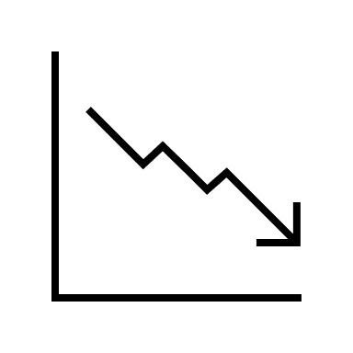
State of Nature: the scale of the problem
Proportion in a poor or bad state
Non-bird species
Habitats
Birds
81%
39%
64%
58% have an unknown or decreasing trend
47% of breeding birds have an unknown or decreasing trend
66% have an unknown or decreasing trend
Source: EEA State of Nature report 2021

Slide 12
What we do know
Nature Restoration Regulation
The regulation sets legally binding restoration targets for all EU member states. These include the restoration of 20% of the EU’s land and sea areas by 2030.Member states must develop national restoration plans and report progress regularly, which will be monitored by the European Commission (by 1st September 2026).
This is a whole of government, whole of society law.

Slide 13
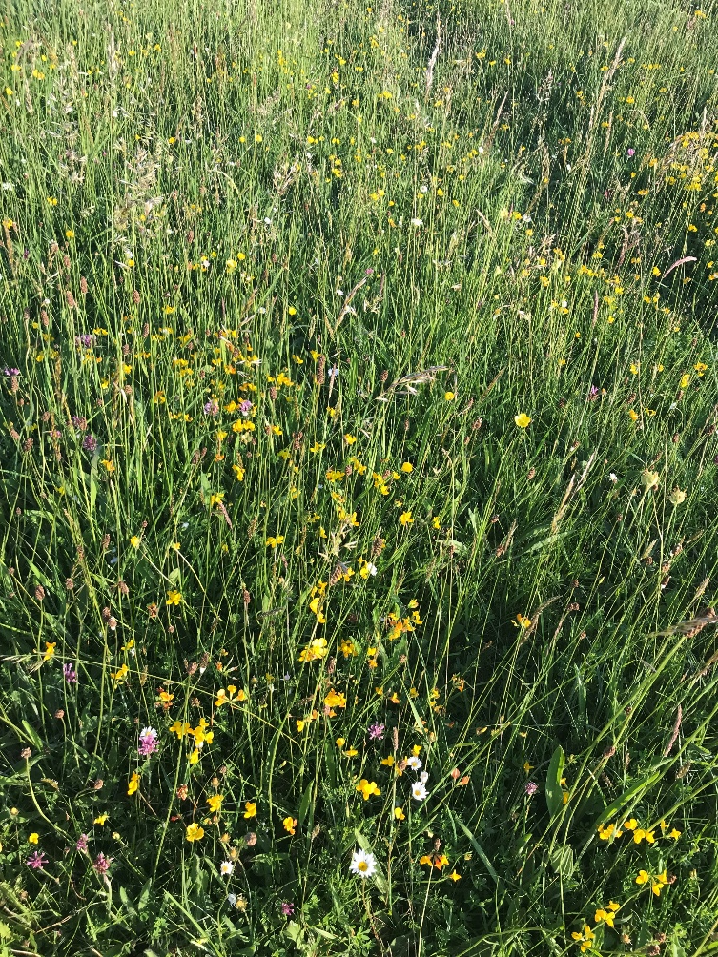
Biodiversity – The Crucial Role of Pollinators in the EU
In the EU, 84% of crop species and 78% of wildflower species rely on animal pollination. Insect pollinators contribute directly to €15 billion of the EU’s annual agricultural output.
Without pollinators, we would, for example, have no almonds, apples, avocados, bananas, chocolate, coffee, tea, tequila, and tomatoes.

Slide 14
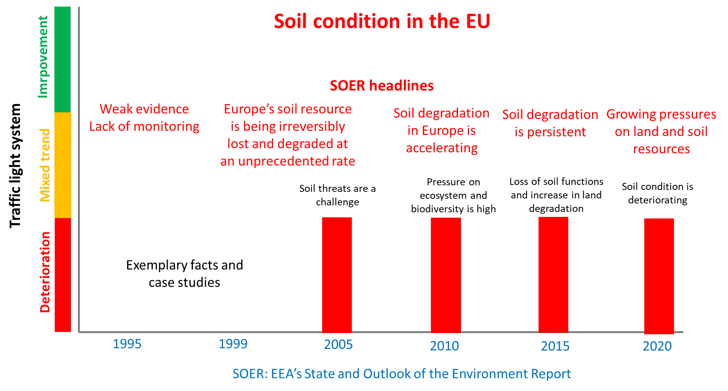
What we do know
Proposal for Soil Monitoring Law
Healthy soils are fundamental for thriving ecosystems and human health.
95% of global food production relies on soil

Slide 15
What we do know
Proposal for Forest Monitoring Law
“that will plug existing gaps in the information on European forests and create a comprehensive forest knowledge base, to allow Member States, forest owners and forest managers to improve their response to growing pressures on forests and strengthen forest resilience.”

Slide 16
Emerging?
Reading through the mission letters for the Commissioner-designates there were a few topics that could be drivers of work or future policies:
Nature valuation
Water resilience

Slide 17
The € value of Biodiversity
“$44 trillion of economic value generation – over half the world’s total GDP – is moderately or highly dependent on nature and its services and, as a result, exposed to risks from nature loss”
World Economic Forum report 2020
Notes:
Can you value the priceless? Can you value biodiversity? Well no you can’t, however in order to influence and change behaviour we have developed measures to understand what biodiversity supplies. We call these ecosystem services, though the social value is probably not as strong as it ought to be.
“Nature’s worth to society – the true value of the various goods and services it provides – is not reflected in market prices because much of it is open to all at no monetary charge.”
“Governments almost everywhere exacerbate the problem by paying people more to exploit Nature than to protect it, and to prioritise unsustainable economic activities.”
Dasgupta report
“Nature’s worth to society – the true value of the various goods and services it provides – is not reflected in market prices because much of it is open to all at no monetary charge.” ,
“But this is not simply a market failure: it is a broader institutional failure too. Many of our institutions have proved unfit to manage the externalities. Governments almost everywhere exacerbate the problem by paying people more to exploit Nature than to protect it, and to prioritise unsustainable economic activities.”
“$44 trillion of economic value generation – over half the world’s total GDP – is moderately or highly dependent on nature and its services and, as a result, exposed to risks from nature loss”
World Economic Forum report 2020
“Human health ultimately depends upon ecosystem products and services (such as availability of fresh water, food and fuel sources) which are requisite for good human health and productive livelihoods.”
WHO, 2015
At least, €15 billion of the EU’s annual agricultural output is directly attributed to insect pollinators.

Slide 18
The value of Biodiversity
In the euro zone, 3 million companies are highly dependent on at least one ecosystem service (ECB, 2023).
In the euro zone, 75% of bank loans to companies are granted to those which are highly dependent on at least one ecosystem service.
EEA and EIB: 2023 Unlocking finance and investments in nature
Notes:
Can you value the priceless? Can you value biodiversity? Well no you can’t, however in order to influence and change behaviour we have developed measures to understand what biodiversity supplies. We call these ecosystem services, though the social value is probably not as strong as it ought to be.
There is a great report, called the Dasgupta report which goes into detail on this.
“Nature’s worth to society – the true value of the various goods and services it provides – is not reflected in market prices because much of it is open to all at no monetary charge.” ,
“But this is not simply a market failure: it is a broader institutional failure too. Many of our institutions have proved unfit to manage the externalities. Governments almost everywhere exacerbate the problem by paying people more to exploit Nature than to protect it, and to prioritise unsustainable economic activities.”

Slide 19
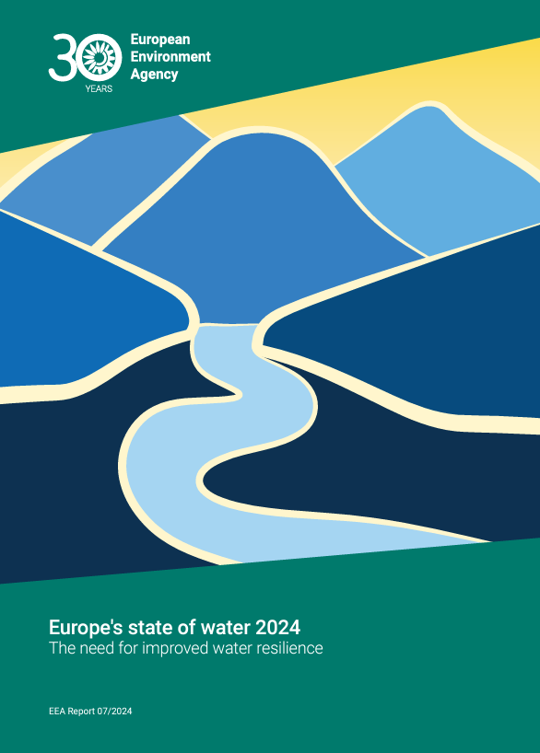
Emerging?
Water resilience
Europe's water is under significant pressure.
Water stress is already occurring in Europe.
For the WFD there has been little improvement since 2010.

Slide 20
Increasing average temperatures
Contact:
Dr Brian MacSharry,
Head of Group, Biodiversity and Nature
European Environment Agency
Brian.macsharry@eea.europa.eu
Decreasing biodiversity
Source:
Ed Hawkins, University of Reading
Miles Richardson, University of Derby

