Slide 1
Ecosystem Accounting in the Central Statistics Office
EIONET Ireland visit by EEA
17 October 2024
Nova Sharkey

Slide 2
Why Ecosystem Accounting?
Tracks changes in ecosystem extent and condition
Way to quantify ecosystem services, and value ecosystem services and assets
Provides a structured approach to assessing the dependence and impacts of economic and human activity on the environment
Statistical standard aligned with System of National Accounts allows for integration of environmental and economic data to support decision-making

Slide 3
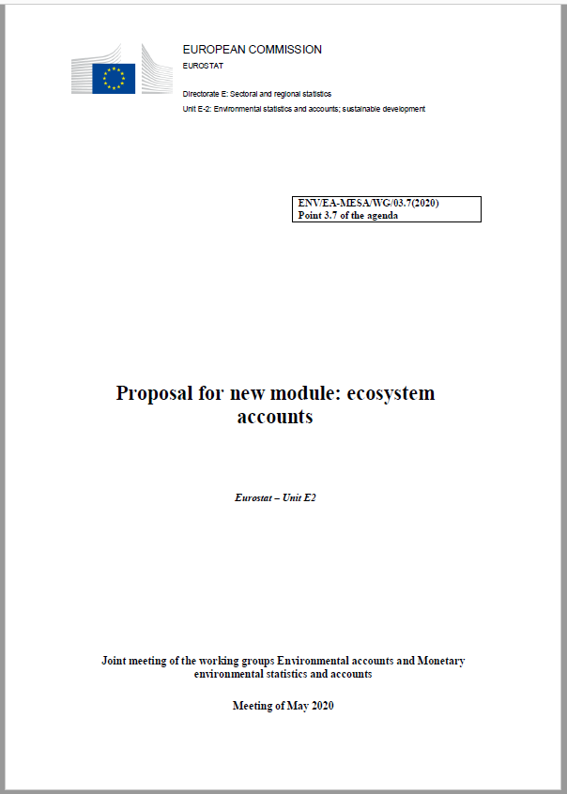
Why the CSO?
Regulation No (EU) 691/2011 on European environmental economic accounts
Amendment to include a module on ecosystem accounts
Mandatory reporting to commence in 2026
https://eur-lex.europa.eu/legal-content/EN/TXT/?uri=COM:2022:329:FIN – Annex IX
Notes:
As part of the EU’s implementation of the System of Environmental and Economic Accounts, a new module on ecosystem accounts has been introduced by Eurostat. This is an amendment to regulation 691/2011 on environmental economic accounts. The new ecosystem accounts module has a range of current and future applications. These new statistics give recognition to the benefits to society that are produced by nature, in coherence with macroeconomic statistics.
There are links with the Nature Restoration law, the Global Biodiversity Monitoring Framework, and climate change policies.
Final approval is expected by the end of this year, which would mean mandatory reporting commences in 2026, with a first reference year of 2024.
Reporting will include extent, condition, and services accounts. Note that monetary valuation is not included in the regulation, but Eurostat will be carrying out a feasibility study.

Slide 4
EU Taskforce
Eurostat Task Force on Ecosystem Accounting
Development of methodologies and Guidance Notes to enable Member States to compile accounts
Testing of Guidance Notes
Formation of Expert Groups
Applicability of methodology in Ireland
Availability of data in Ireland
Feedback is discussed at the Taskforce and the guidance notes are edited.
Voluntary data collection
Notes:
To help with the implementation of the regulation, Eurostat has set up a Task Force on Ecosystem Accounting. Ireland, represented by the CSO, has been there from the beginning, in 2020. we have made significant contributions to the development of guidance notes, to be used by all EU MS in the compilation of the accounts.

Slide 5
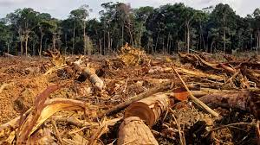
EU Requirements
Ecosystem Services Accounts
Extent Accounts
Condition Accounts
PM
Nature-Based Tourism
Air Filtration
✓
Crop Provision
Local Climate Regulation
?
$$✗$$
CO₂
Global Climate Regulation
Wood Provision
Crop Pollination
Notes:
Extent accounts – what ecosystems do we have, where are they, how does this change over time
Condition accounts – tell us about the condition of the ecosystems, which impacts their function and capacity to provide ecosystem services
Ecosystem services accounts – record the biophysical flows of ecosystem services

Slide 6
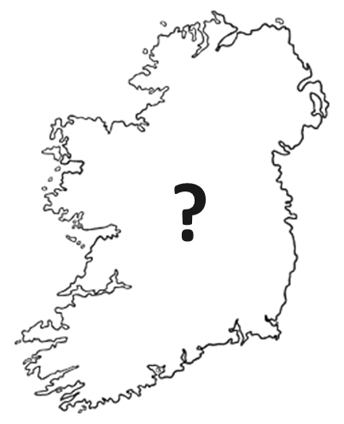
Extent Accounts
Category | Name of ecosystem type
1 | Settlements and other artificial areas
2 | Cropland
3 | Grassland (pastures, semi-natural and natural grassland)
4 | Forest and woodland
5 | Heathland and shrub
6 | Sparsely vegetated ecosystems
7 | Inland wetlands
8 | Rivers and canals
9 | Lakes and reservoirs
10 | Marine inlets and transitional waters
11 | Coastal beaches, dunes and wetlands
12 | Marine ecosystems (offshore coastal, shelf and open ocean)
Mandatory reporting at Level 1 of EU Ecosystem Typology
Every 3 years
Opening and closing extent
Conversion matrix
Notes:
For the extent accounts, reporting will be on a three-yearly basis, and include extent accounts with opening and closing areas for each ecosystem type, as well as a conversion matrix. Mandatory reporting will be at Level 1 of the EU Ecosystem Typology that you can see here, and member states will be able to report at the more detailed level 2 on a voluntary basis.

Slide 7
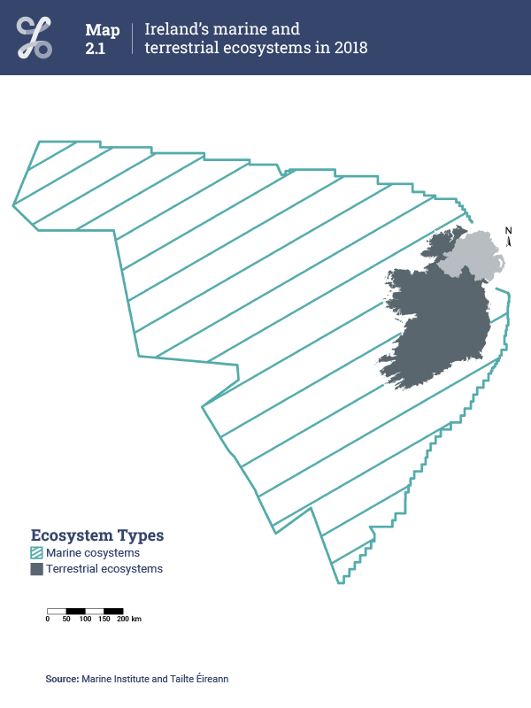
Extent Accounts
“recording the areas and changes in areas for each ecosystem type within the
national territory”
they cover
“the terrestrial (including freshwater) and marine ecosystems on the national territory”
also required is a
“a conversion matrix recording conversions between ecosystem types
between two points in time”
78,806,956 ha
Notes:
Ecosystem extent accounting involves recording the areas and changes in areas for each ecosystem type within the national territory. They cover the terrestrial (including freshwater) and marine ecosystems on the national territory. Eurostat also requires a conversion matrix to record conversions between ecosystem types over time. The figure on the right here is Ireland’s national territory and this depicts the entirety of Ireland’s ecosystem accounting area.

Slide 8
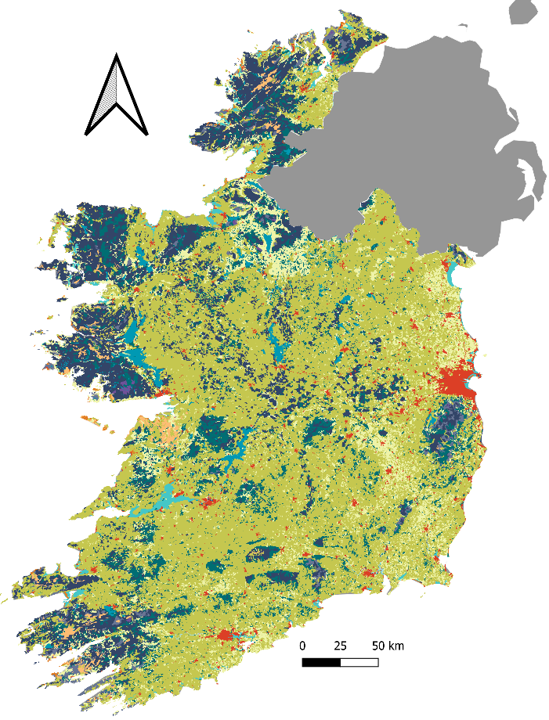
Crosswalk between the EU Level 1 ecosystem typology and CLC Accounting Layers
EU level 1 ecosystem extent 2018
EU Level 1 ecosystem type category | EU Level 1 ecosystem type classes | CLC Accounting Layer Level 3 classes
1 | Settlements and other artificial areas | 111 Continuous urban fabric
 |  | 112 Discontinuous urban fabric
 |  | 121 Industrial or commercial units
 |  | 122 Road and rail networks associated land
 |  | 123 Port areas
 |  | 124 Airports
 |  | 131 Mineral extraction sites
 |  | 132 Dump sites
 |  | 133 Construction sites
 |  | 141 Green urban areas
 |  | 142 Sport and leisure facilities
2 | Croplands | 211 Non-irrigated arable lands
 |  | 222 Fruit trees and berry plantations
 |  | 242 Complex cultivation patterns
 |  | 243 Agriculture mosaics with significant natural vegetation
3 | Grasslands | 231 Pastures
 |  | 321 Natural grasslands
… | … | …
… | … | …
11 | Marine inlets, transitional waters and wetlands | 421 Salt marshes
 |  | 423 Intertidal flats
 |  | 521 Coastal lagoons
 |  | 522 Estuaries
12 | Marine ecosystems | NA
13 | Balancing item | 334 Burnt areas
Notes:
It is worth pointing out that the different categories in the CLC accounting layers correspond to various landcover types. It was necessary to do a crosswalk to between these and the different ecosystem types of the European ecosystem typology. Since publishing, we had some important feedback from our expert group, in particular that for Ireland the CLC class 243 (“Agriculture mosaics with significant natural vegetation”) should be actually considered as grasslands and not croplands. This is also more consistent with the National Land Cover Map. So, we decided to move this class into croplands ahead of the voluntary data collection. Because this impacts cross-country comparability, this has now prompted Eurostat to investigate the issue. The EEA have now agreed with our reclassification and have raised the possibility of varying the assignment of CLC classes by environmental zones. Given that CLC class 243 is around 400,000 ha in Ireland, this highlights the absolute necessity of involving national experts in developing methodology for official statistics.

Slide 9
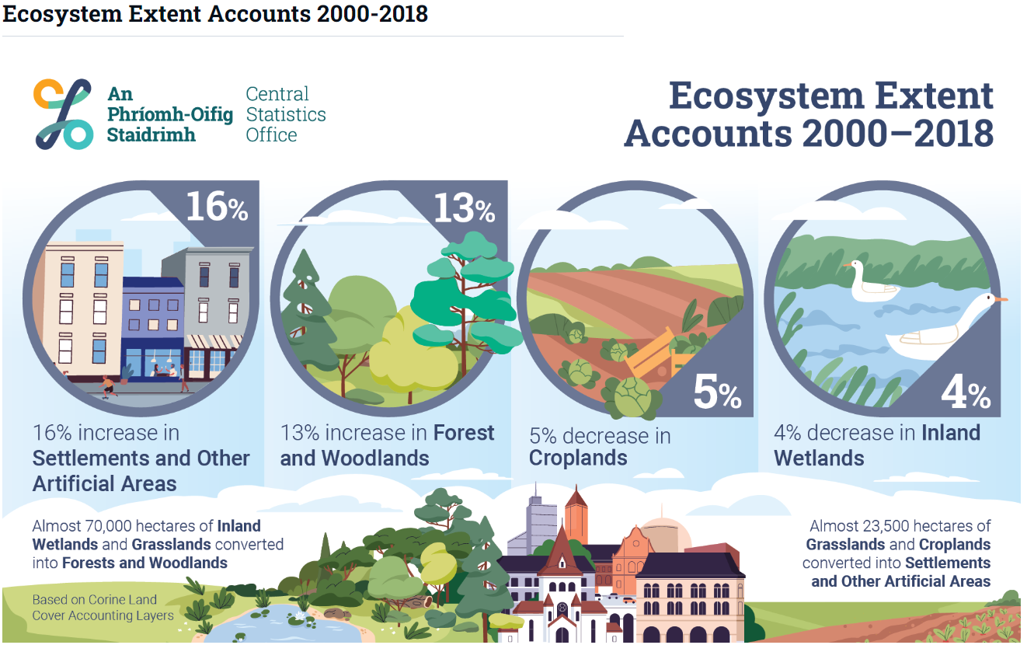
Ecosystem Extent Accounts 2000-2018 (24 October 2023)
Notes:
Last October we published ecosystem accounts at level 1 of the EU ecosystem typology for the period covering 2000-2018. This publication included the accounting tables, conversion matrix

Slide 10
Condition Accounts
Ecosystem Type | Condition Indicator | Unit
Settlements and other artificial areas | Green areas in cities and adjacent towns and suburbs | %
 | Concentration of particulate matter with a diameter of up to 2.5 μm in cities | μg/m³
Grasslands and Croplands | Soil organic carbon in topsoil | Tonne/ha
 | Common farmland bird index | Index
Forests and woodlands | Dead wood | m³/ha
 | Tree cover density | %
 | Forest bird index | Index
Coastal beaches, dunes and wetlands | Share of artificial impervious cover | %
✓
$$✗$$
Notes:
Condition accounts will be reported on a three-yearly basis as well, to coincide with the extent accounts. For the regulation, reporting of 8 different condition indicators will be mandatory, for 5 different ecosystems.

Slide 11
Condition Accounts
Eurostat Guidance Note still under development
Preliminary condition accounts published for:
Forests and woodlands
Deadwood
Tree Cover Density
Grasslands and Croplands
Common Farmland Bird Index
✓
$$✗$$

Slide 12
Services Accounts
Ecosystem Services Accounts
Reported in supply and use tables.
Physical quantity is mandatory.
Annual
PM
Nature-Based Tourism
Air Filtration
Crop Provision
Local Climate Regulation
CO₂
Global Climate Regulation
Wood Provision
Crop Pollination

Slide 13
Crop Provision
Contribution of ecosystems to plant growth as approximated by the quantity of harvested crops
Reporting unit: Tonnes of crops
Grasslands, Croplands, and Settlements and Other Artificial Areas
Frontier Series publication

Slide 14
Wood Provision
Contribution of ecosystems to the increase in timber available for harvesting
Reporting unit: Net annual increment (cubic metres)
Data from National Forest Inventory
Frontier Series publication

Slide 15
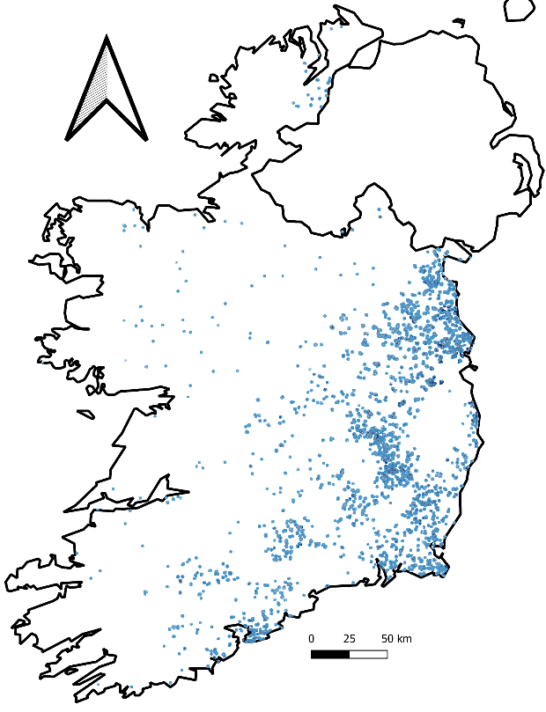
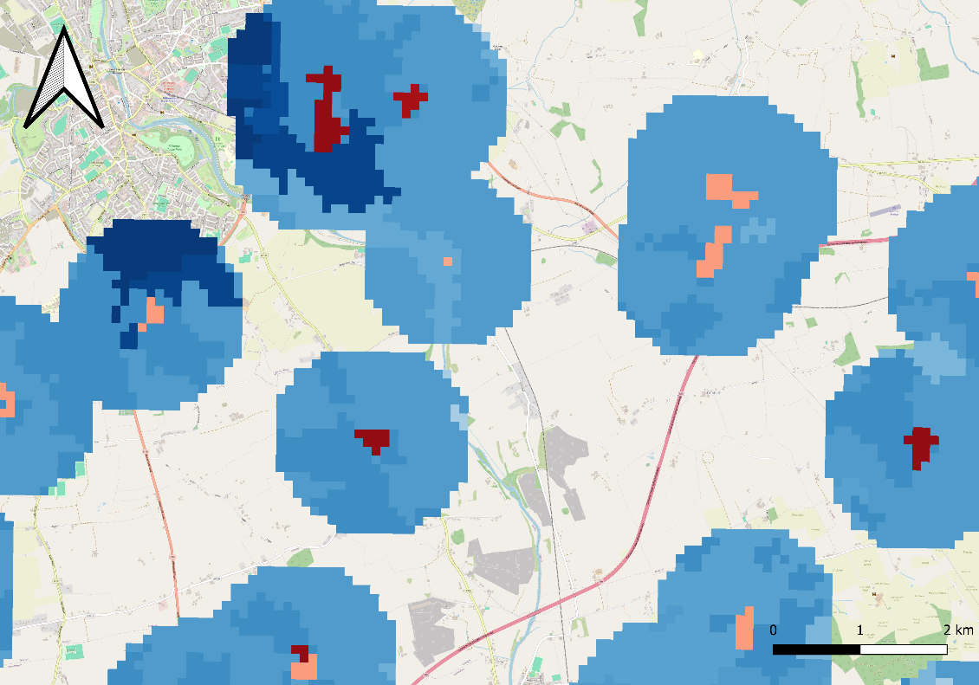
Crop Pollination
Contribution by wild pollinators to the production of crops
Reporting unit: Tonnes of pollinator-dependent crops that can be attributed to wild pollinators
Model potential habitat, link to pollinator-dependent crops
Frontier Series publication planned
Habitat potential map (long distance pollinators)

Slide 16
Global Climate Regulation
Contribution of ecosystems to the net sequestration and storage of carbon
Reporting unit: Tonnes of carbon
Net sequestration:
Emissions and removals from EPA National Inventory Report
Storage:
Calculation of baseline stock per ecosystem type
Baseline stock is the focus of ongoing work

Slide 17
Local Climate Regulation
Contribution of ecosystems to regulating ambient atmospheric conditions in urban areas
Reporting unit: The reduction of temperature in cities in degrees Celsius on days exceeding 25°C
Ongoing work to develop a spatial model including data on tree cover density and temperature data

Slide 18
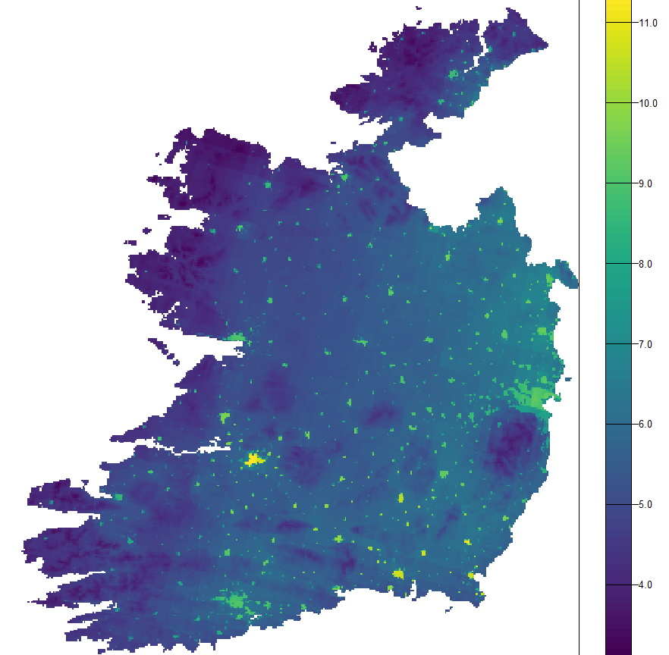
Air Filtration
PM
Contribution of ecosystems to filtering air-borne pollutants
Reporting unit: Tonnes of particulate matter adsorbed
Spatial data on PM concentrations is combined with extent map and deposition velocity factors
Ongoing work focused on:
Spatial modelling with a higher temporal resolution
Use of national data
Modelling approach incorporating Leaf Area Index

Slide 19
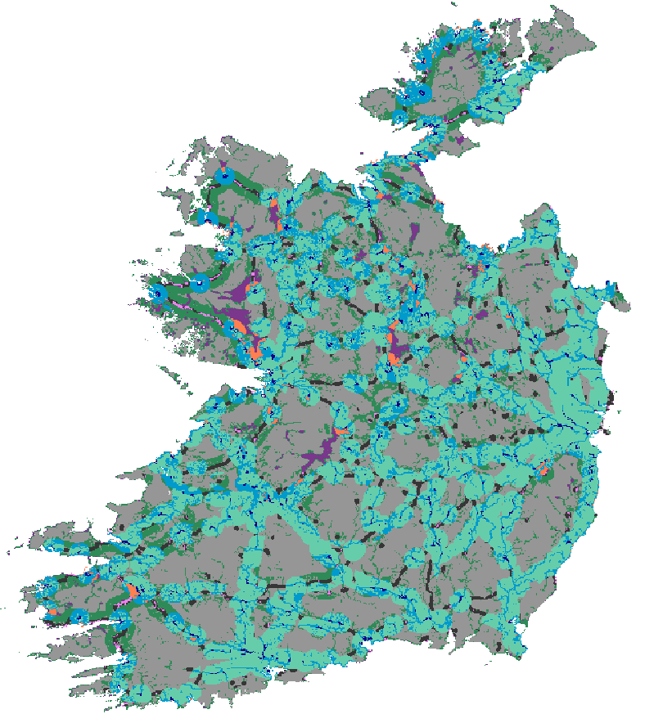
Nature-Based Tourism
Use and enjoy the environment through direct, in-situ, physical and experiential interactions.
Reporting unit: Overnight stays.
Total overnight stays reported by CSO Tourism.
Scaled down and attributed to ecosystem types using the recreation potential map.

Slide 20
Future Plans

Slide 21
What will we do in the next 12 months?
National and international engagement
Eurostat voluntary data collection begins Q4 2024
Household survey – trips to green and natural spaces
Publication on Crop Pollination service
Revised Ecosystem Extent – incorporating national data
Marine ecosystem accounts
Flood control ecosystem service

Slide 22
Thanks! ecosystems@cso.ie

