Slide 1
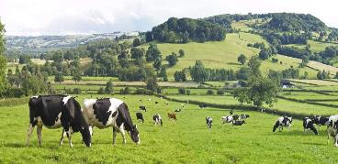
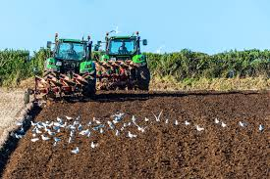
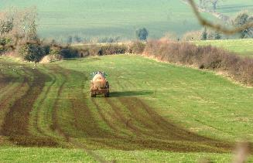
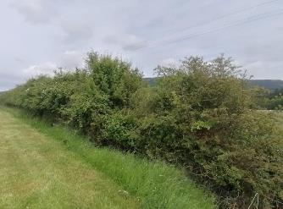
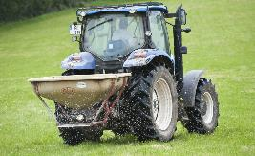
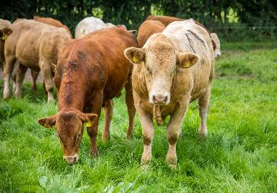
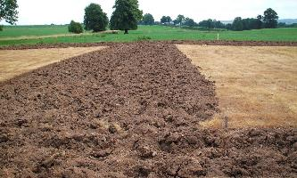
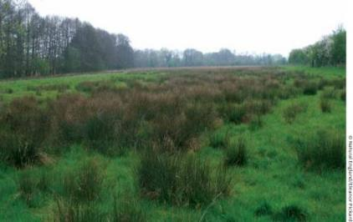
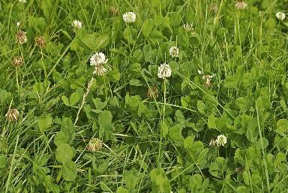
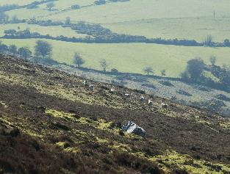
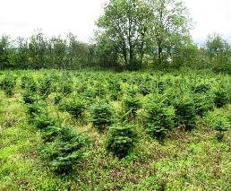
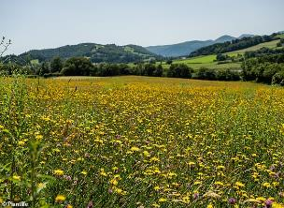
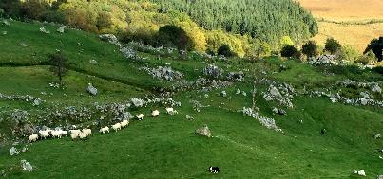
EO for Land-Use Policy in Ireland
Stuart Green, Teagasc
Ploughing
Dairy
Slurry Spreading
Hedges &
Field Margins
Fertilizers
Soil
Grass Species
Re-wetting
Beef
Marginal Land
Forestry
Re-wilding
Sheep Farming

Slide 2
Land Use information is suddenly in huge demand in Ireland
New Accounting Rules and Targets for GHG emission reduction in land use (soon to be AFOLU)
Nitrates and Water Quality Regulation
New Planning Rules
Nature Restoration Act
    BUT …….
Ireland is playing “Catch-up” in terms of spatial data infrastructure for land use – can Copernicus help?

Slide 3
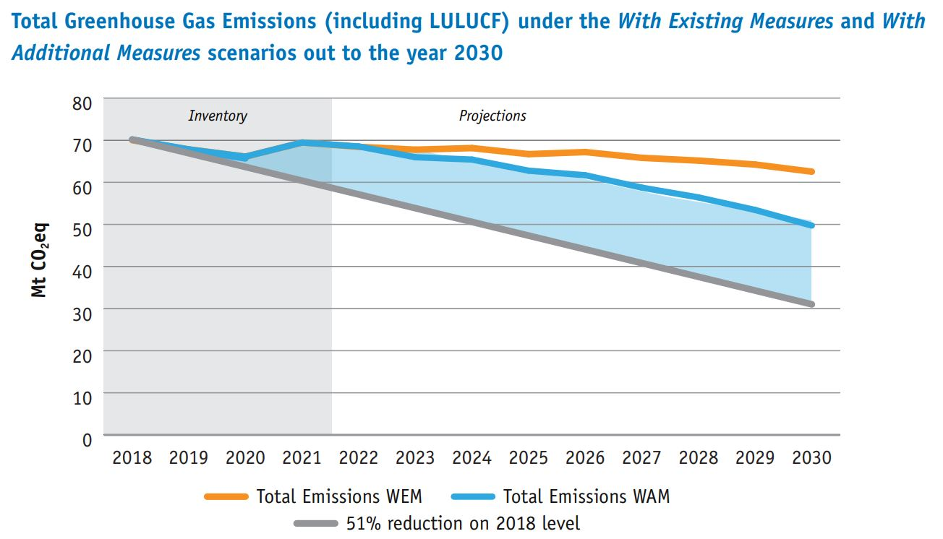
Policy Context Ireland
In Ireland LULUCF is a net source of carbon in all years. This result is determined largely by the CO₂ emissions from Grassland and Wetlands, due to drainage of organic soils, offset somewhat by Forest Land, which acts as a major carbon sink.
Most land is agriculture and privately owned
Afforestation rates are very low
“RE-wetting” is currently being examined as extra measure

Slide 4
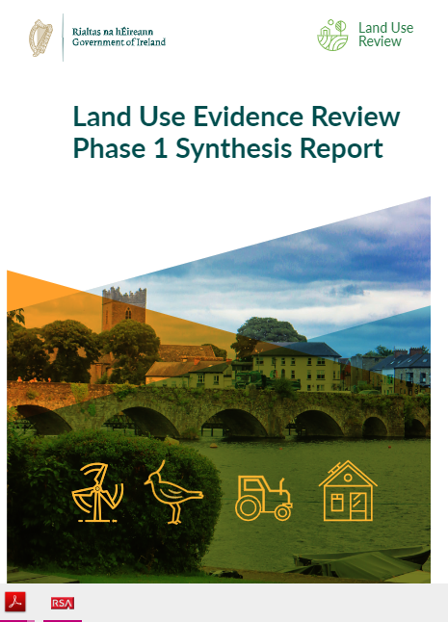
Land Use Review 2023
11 Documents
19 recommendations
800+ pages
We will look at a few of the recommendations and
See the role EO might play
https://www.gov.ie/en/publication/f272c-land-use-review-phase-1/

Slide 5

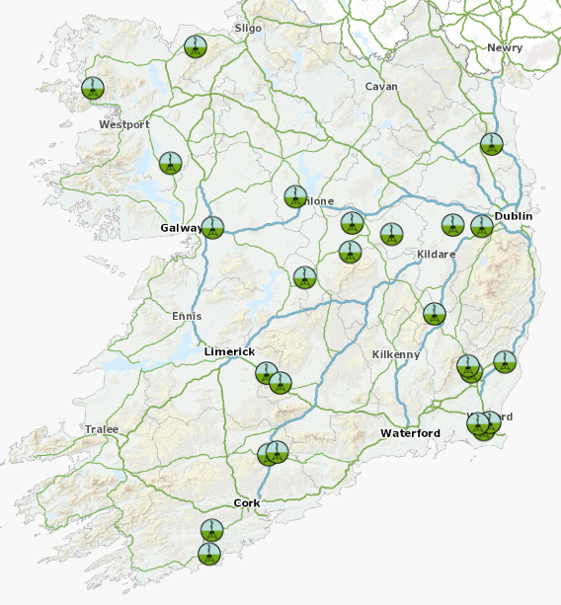



The technical context: Ireland
https://www.teagasc.ie/environment/climate-change--air-quality/signpost-programme/
https://terrainai.com/
https://www.teagasc.ie/environment/climate-change--air-quality/soil-carbon/national-agricultural-soil-carbon-observatory/

Slide 6
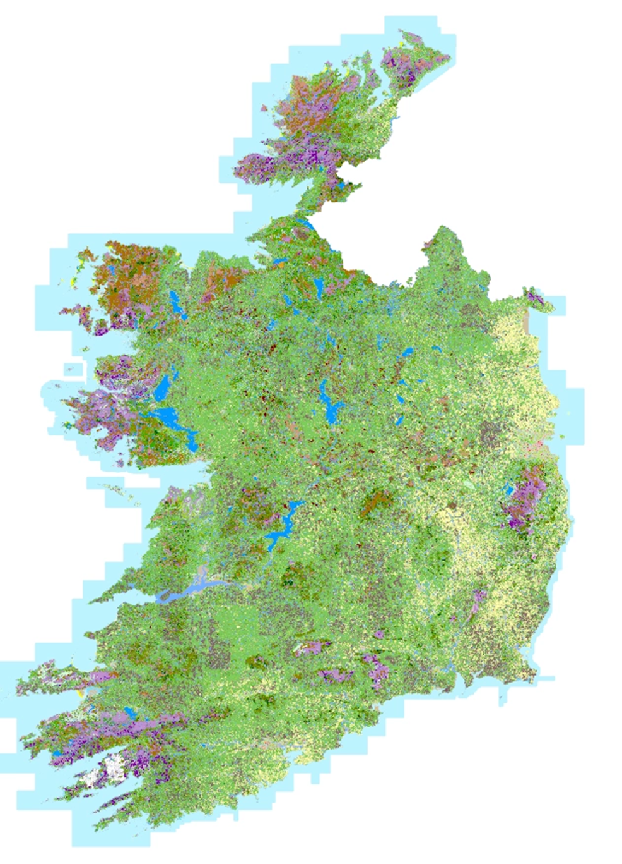
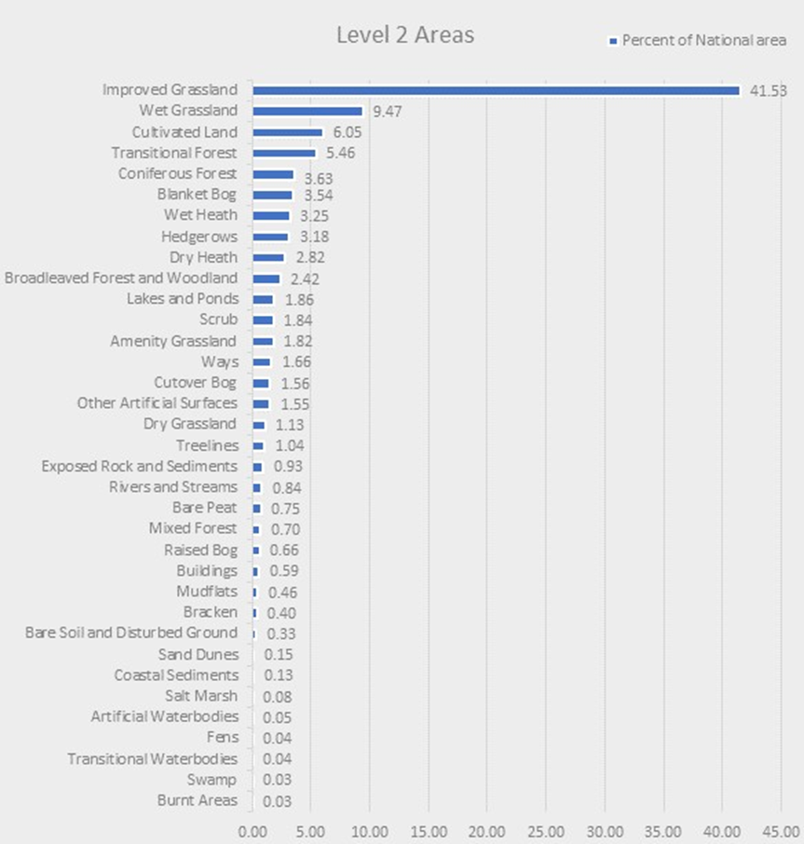
Our newest baseline
TE NLC 2018
Irish Farms Occupy 65% of Ithe country- average size approx.
37Ha. Very fragmented – <5 % of dairy farms
are in a single block

Slide 7
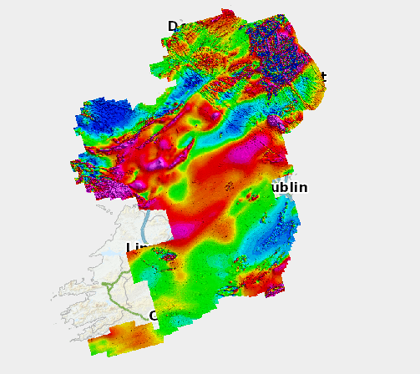
1. Develop a national monitoring network for soils. National monitoring network for soils should be developed to collect ongoing detailed data about soil health.
Role of EO .
  Soil Colour
  Soil Texture
  Soil Depth
  Soil Drainage
  Currently national soil sampling program
  National Airborne Geophysics _TELLUS https://dcenr.maps.arcgis.com/apps/MapSeries/index.html?appid=6304e122b733498b99642707ff72f754

Slide 8
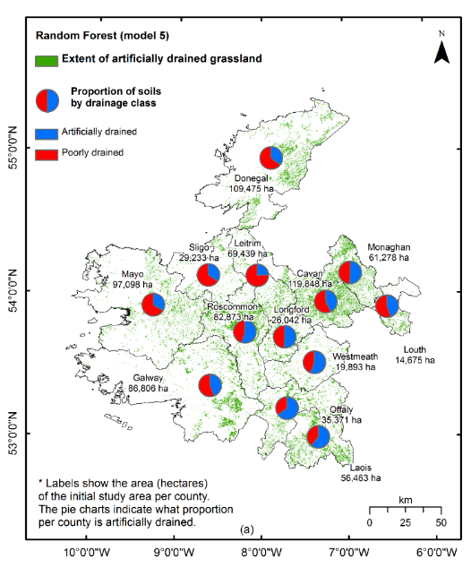
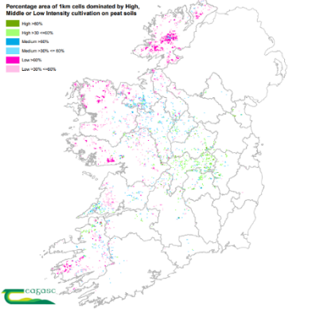
Identify Drainage
Control and Management of water table one of the major policy tools to achieve 2030 targets. With satellites we can detect drains installed on Mineral soils and Organic

Slide 9
2. Continue to invest in soils mapping at detailed scales.
Topography - soil mapping is a 3D exercise
Soil Modelling – EO as input
Soil Info System http://gis.teagasc.ie/soils/

Slide 10
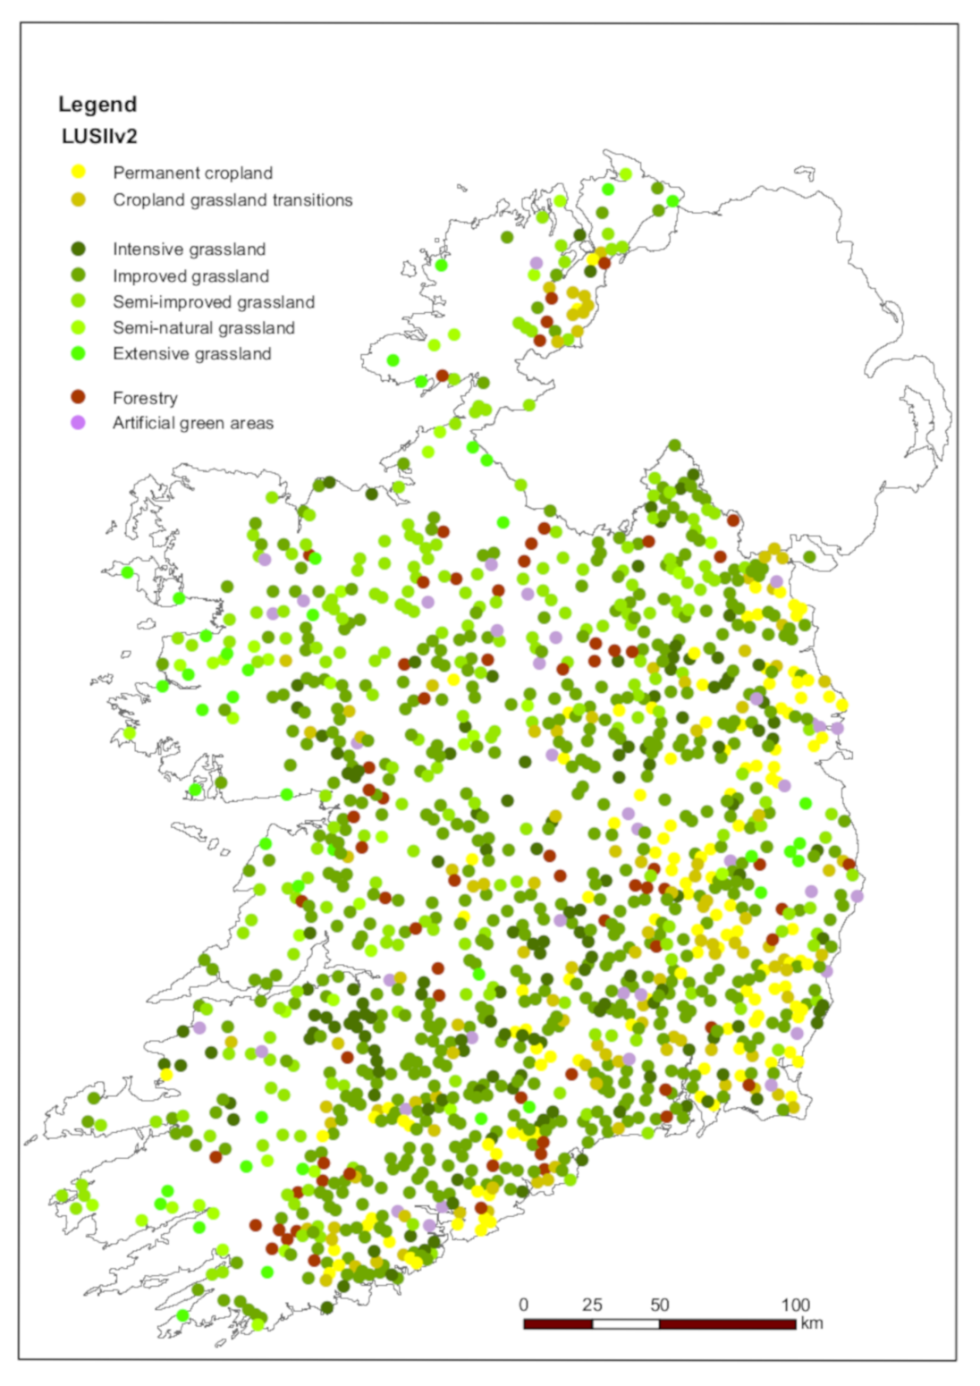
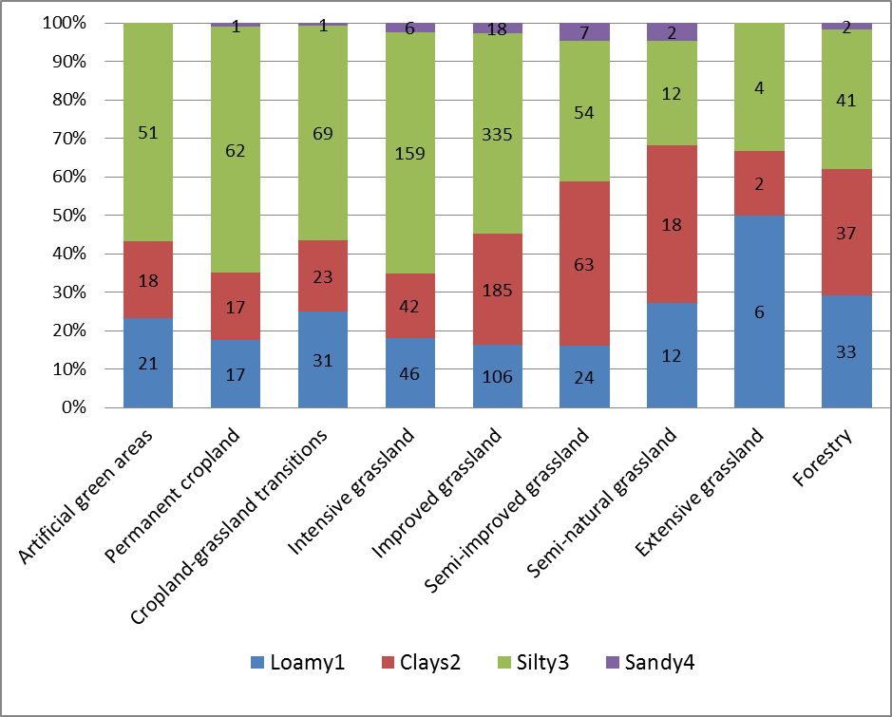
In the SOLUM project LUCAS data points formed the basis
Of LUSII- the land soil Inventory of Ireland
https://www.epa.ie/publications/research/climate-change/research-422-soil-organic-carbon-and-land-use-mapping-solum.php

Slide 11
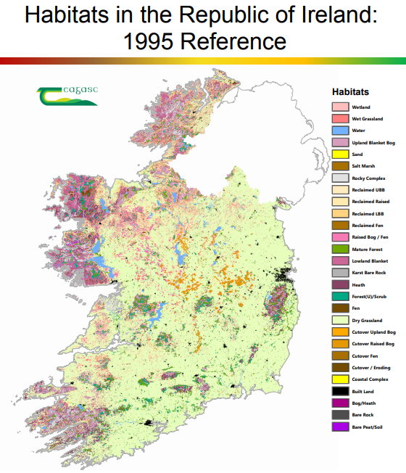
6. Indicators that the measure outcomes of agri-environmental schemes or incentives, particularly given the ongoing drive for results-based scheme design, should be included in the indicator set.
Habitat Mapping – need to go beyond extent mapping – look at condition , chacteristics, services.
Sub Ha resolution – consider a summer and winter map
With regard to condition and service – explore ideas of
Functional traits
Hedgerows and hedgerow removal – still apparent net loss
In EO record for Hedgerows – removal detection with S1 data
Forest mapping
Wildfires

Slide 12
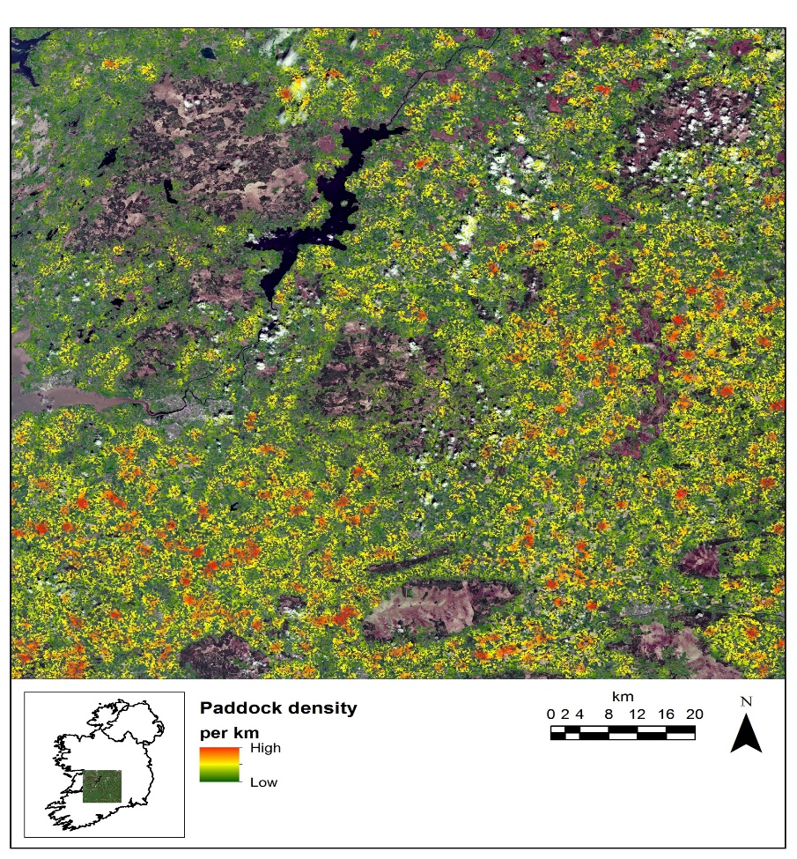
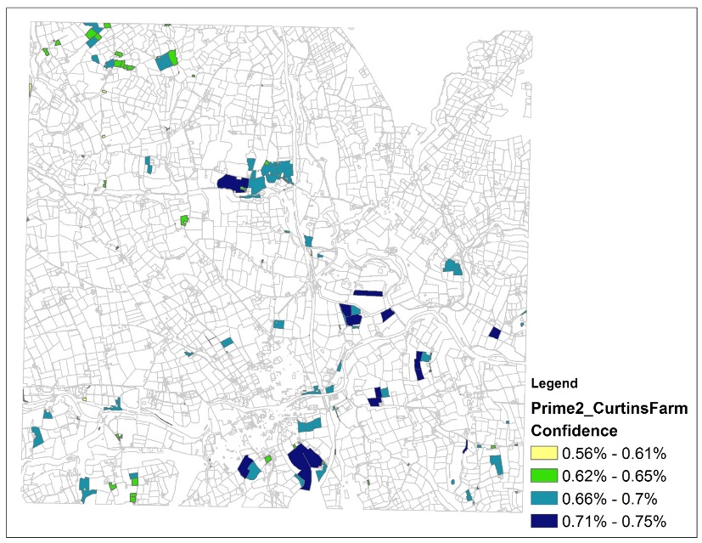
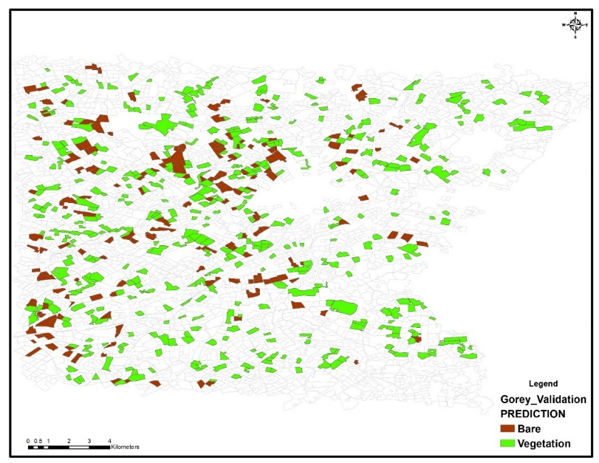
Grassland/Cropland management characterisation
National Paddock Map
National Permanent Grassland Map
Using 40 year archive of LANDSAT- map of all true
permanent grasslands being developed
National Winter Bare Soil Map
Using sentinel 1 RADAR data- method to detect fields bare of vegetation in winter nearly complete. To be rolled out and applied to winter 22/23 within month.
New EO statistical technique, outperforms ML
IMPACT: Method adopted by Dept of Ag for 2023 going forward as part of new evaluation approaches to support CAP payments.
IMPACT: Paper published in GeoCarto

Slide 13
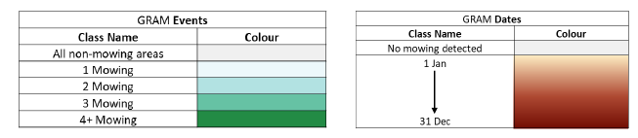
EXAMPLE : HRL –Vegetated Land Cover Characteristics from Copernicus
Annual production 2017/2018 –2021 release in 2024
•Tree cover / Forests
•Grassland : Grassland Mowing Events and Dates
•Crop Types/Cropping Patterns
HRL –Small Woody Features
EU Grassland Watch for N200 sites gives some possibilities of what
To examine
Forest Density 10m
Leaf type 10m
Grassland 10m

Slide 14
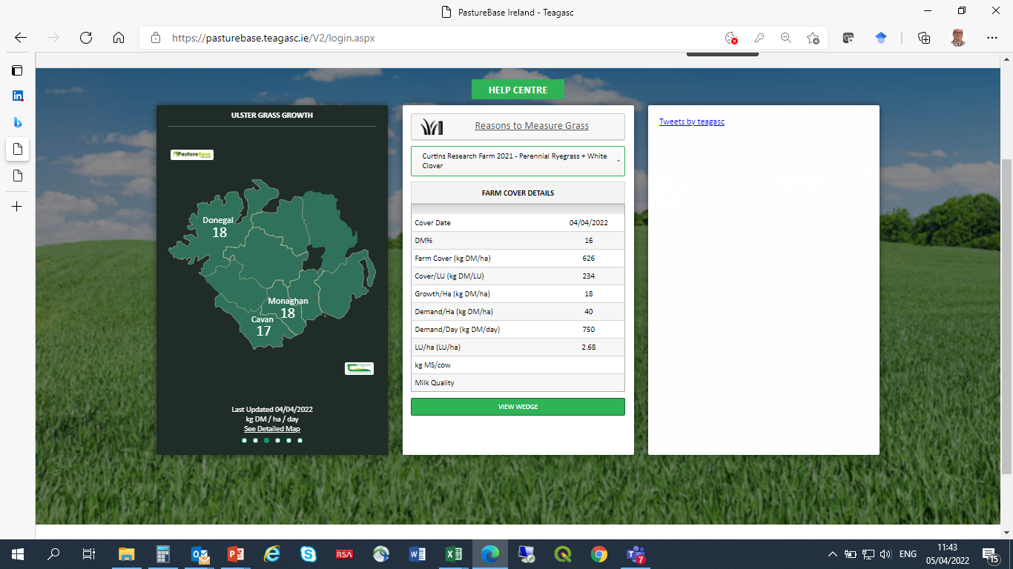
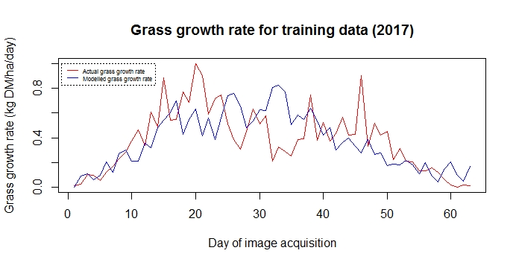
PastureBase

Slide 15
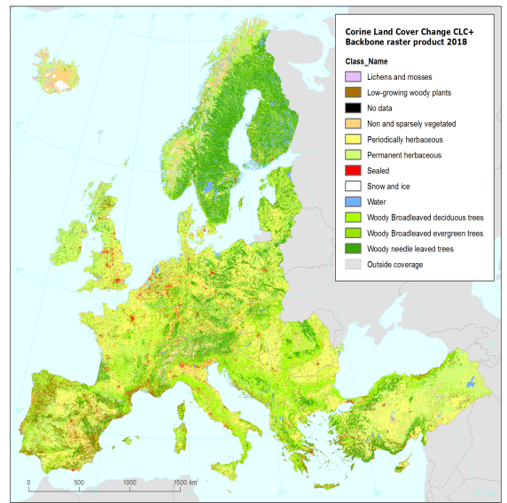
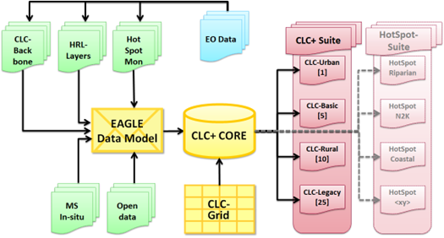
7.Develop a land classification system for Ireland. The EAGLE land-use attributes have been used in this report as a framework for explaining the characteristics of land use in Ireland. A land-use classification that is more suited to Ireland should be developed as part of the development of land-use maps for Ireland, that can integrate with other international classifications like the EAGLE scheme.

Slide 16
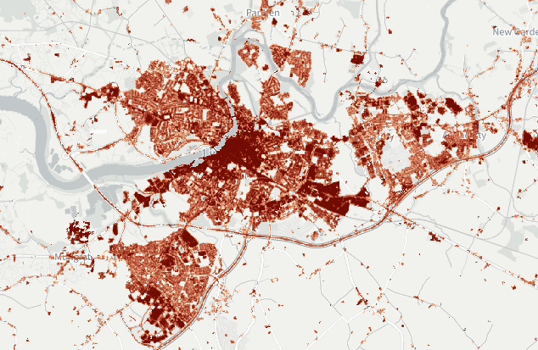
8.Use spatial data to develop indicative maps, at a national level, to determine high or low suitability for a subset of land uses (starting with energy generation and forestry). National indicative maps can aid development of land-use strategies at a national level but can also help to identify locations that are highly suited – or not suited – to certain activities so that communities can be informed and engaged in local decisions
This is asking for on demand , localised land use data.
A need to move away from LU Maps as a product to land-use mapping as a service- when and where its needed
Again there is a new corollary in “CLC+ Instances”
Urban Atlas 2021 – urban greening product

Slide 17
9. Ensure that ecosystem mapping is closely aligned with land-use mapping.
Does this mean – thematic, spatial , temporal? Eagle gives some guidance on thematic but have to be aware that ecosystems and land use are multi-factoral – any parcel of land can offer multiple land uses and ecosystem services- often simultaneously . Also both land uses and ecosystem services can be scale dependent ( the “wood for the trees problem”).
HR-WSI - 2 water products provide information on water cover duration and on the characteristic of the presence of open water surfaces.
Extent statistics from Eurostat and CSO

Slide 18
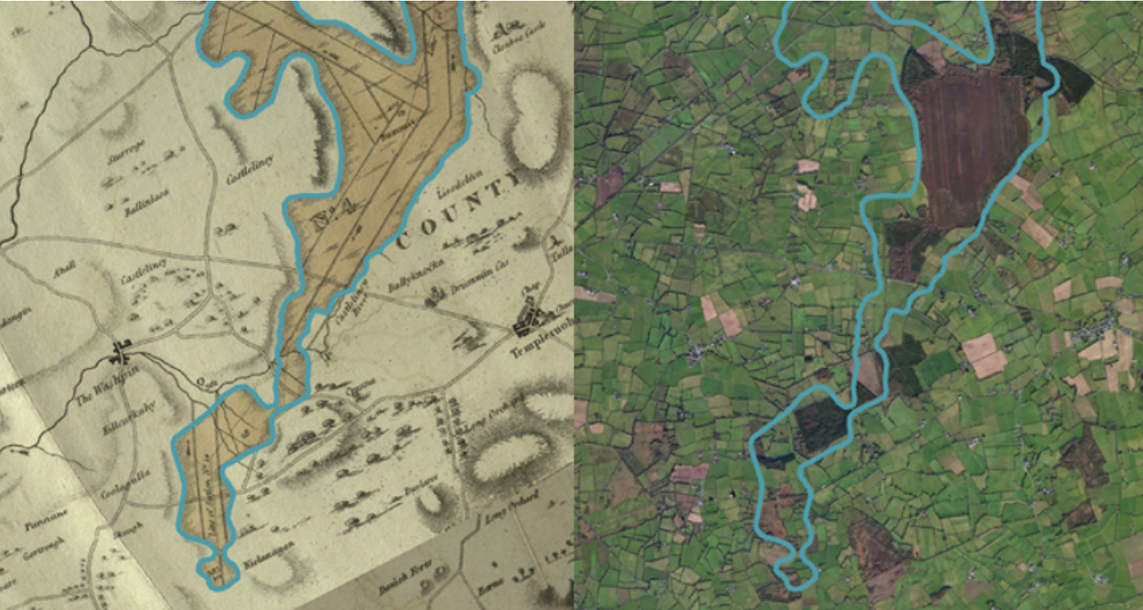
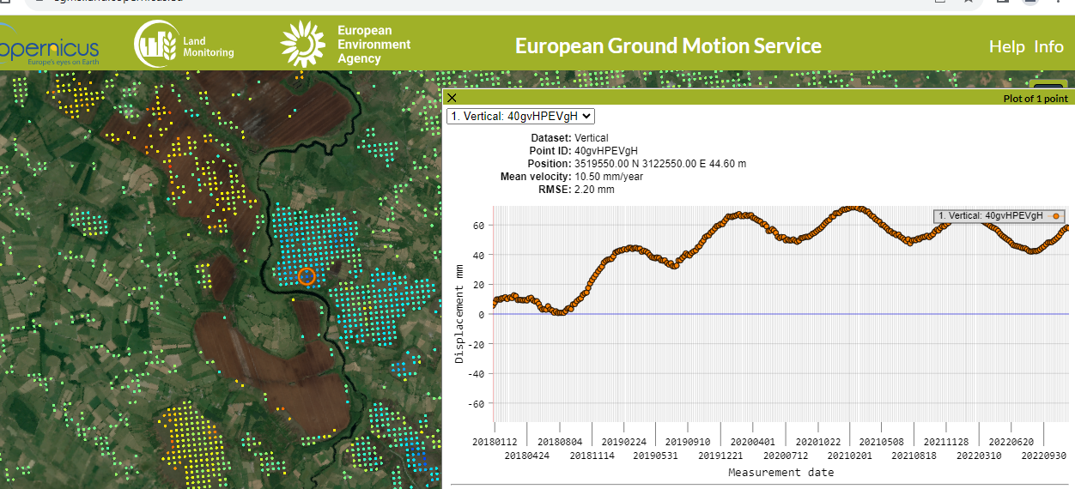
10. Create a peatland map of Ireland and monitor changes to peatland, to enable planning and to track the progress and benefits of peatland restoration and rehabilitation
Extent
Depth
Condition
Hydrology
Ecosystem Service
Medium Term reporting for GHG
Updates every 3-5 years
https://egms.land.copernicus.eu/

Slide 19
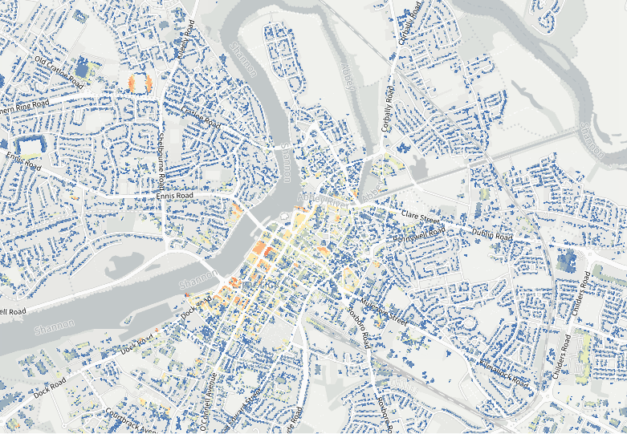
18. Invest in land, soil and ecosystem mapping capacity in Ireland, in recognition of the fact that good spatial data, including data in relation to land and ecosystem health, are needed to support good land-use decisions.
Much of the Investment has been made – we have large scale analysis capability but we lack people and ground truth .
Still ad hoc production relaying on good will
Still needs ground truth – data sets like LUCAS or
AGRISnap can fill the gap – EOAI still needs ground
Truth and training.
Consider either citizen science or formal inventory
(LUCAS 2021 has detailed grass data )
The big data gap – is the Third Dimension

Slide 20
19. Engage with land-use mapping stakeholders to develop a national specification for land-use mapping in Ireland. To progress with creating national land-use maps commence with stakeholder engagement in the immediate term to identify the necessary land-use products and classification schemes.
Feed into Future CLMS plans. Put more resources into assessing CLMS products at Irish scale.

Slide 21
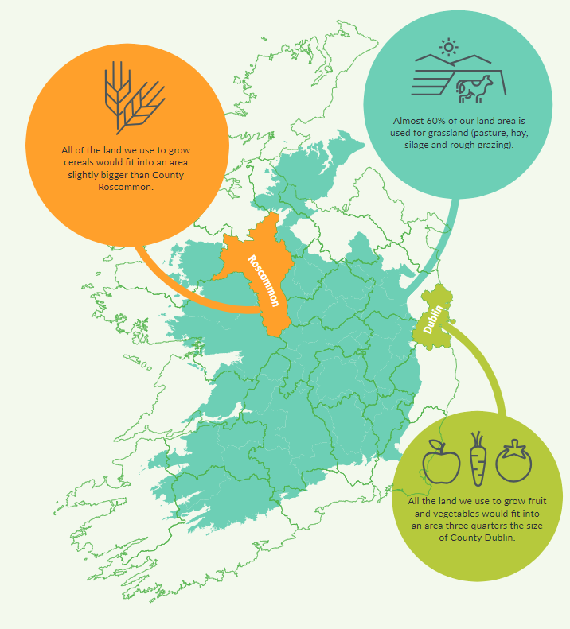
Take away for Ireland
We are at a turning point in land use policy in Ireland
We are moving rapidly from a position of ignorance to one of overwhelming data
Government will demand information and engagement
We need to align our ambition with our capabilities and to build on work of others
We can exploit Copernicus products more but are also in positon to help improve products
https://www.gov.ie/en/publication/f272c-land-use-review-phase-1/

